Slide 1
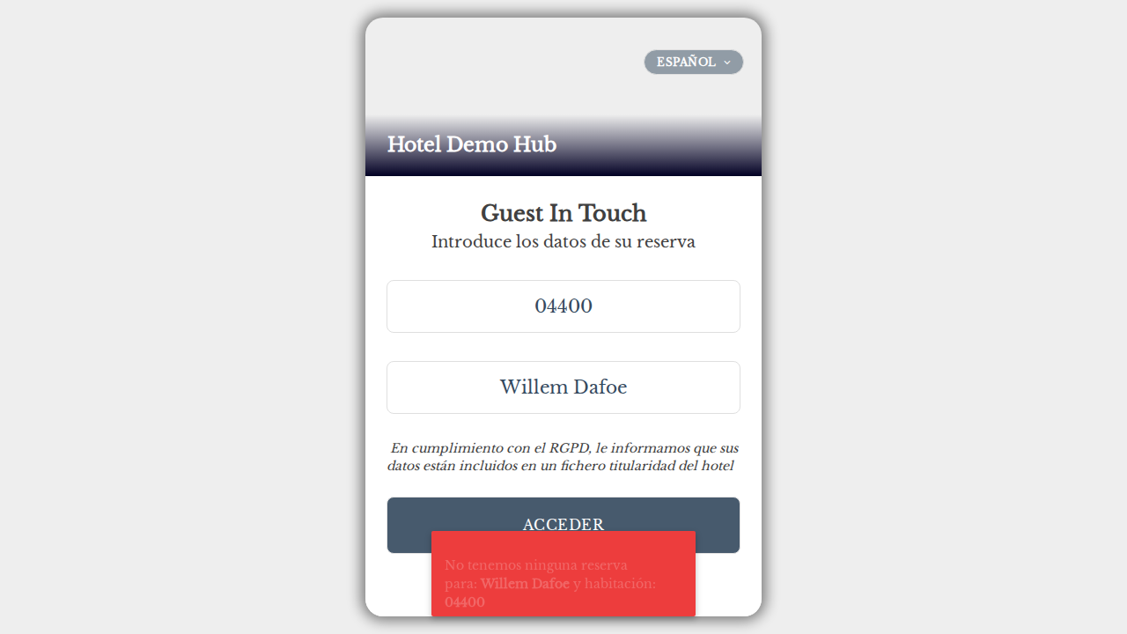
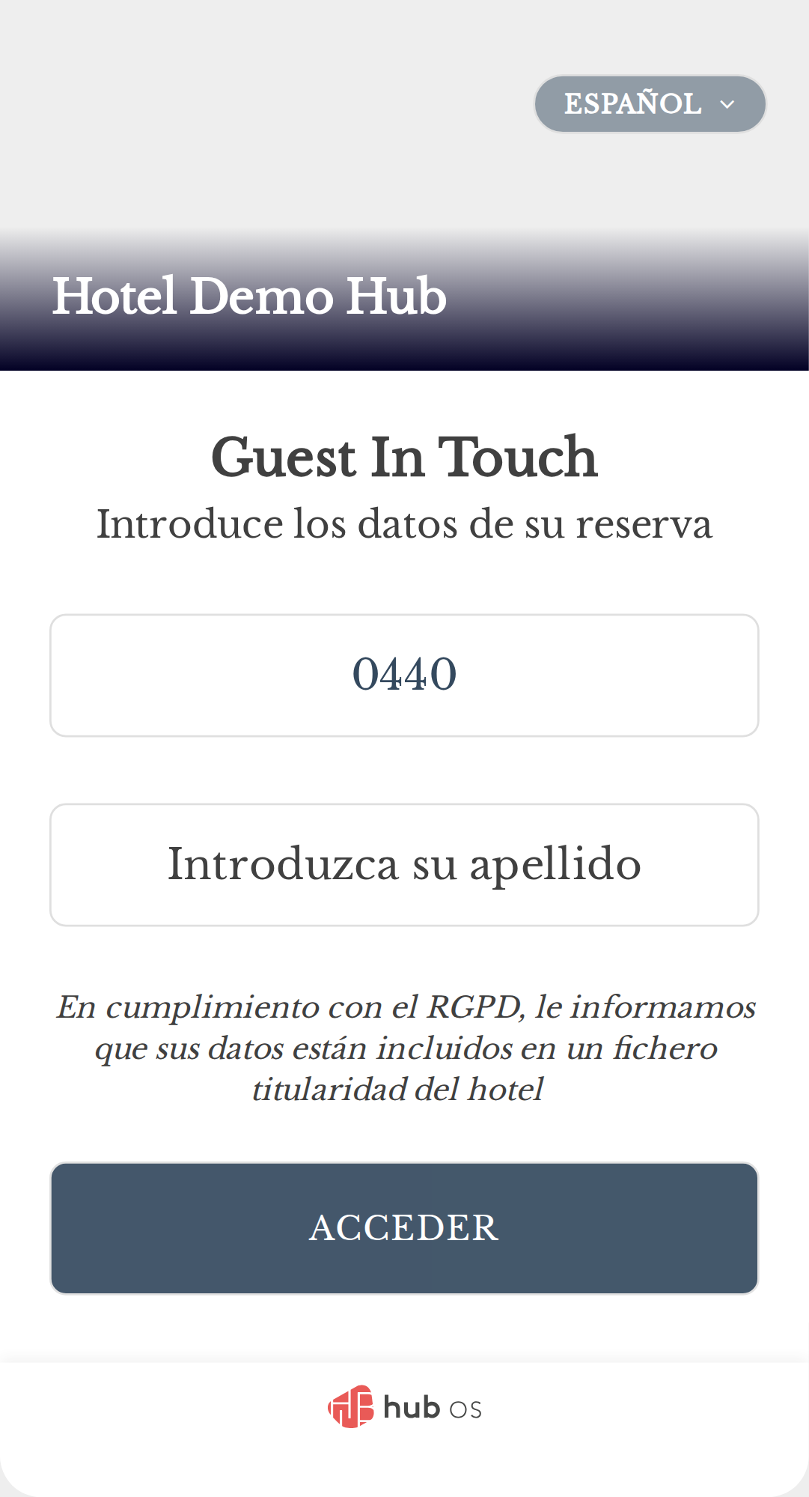
HubOS QA Engineer Homework XGA
22 dic 2025
should login with correct room and surname (A)
const loginPage = new LoginPage(page);
// Use POM helpers: fill inputs and submit
const lp = new LoginPage(page);
await lp.fillRoom(ROOM);
await lp.fillName(CORRECT_LOGIN);
await lp.submitLogin(ROOM, true);
await expect(lp.fandbForm).toContainText(ROOM); // 0440
await expect(lp.fandbForm).toContainText(CORRECT_LOGIN); // Dafoe
await expect(lp.hotelName).toContainText(DEMOHUB); // "Hotel Demo Hub"
HubOS
Page 1

Slide 2
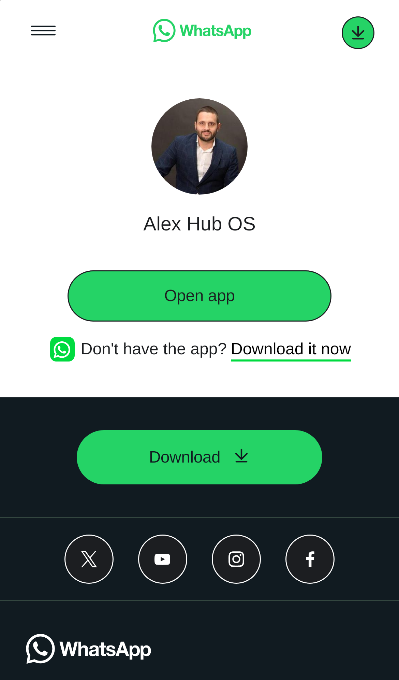
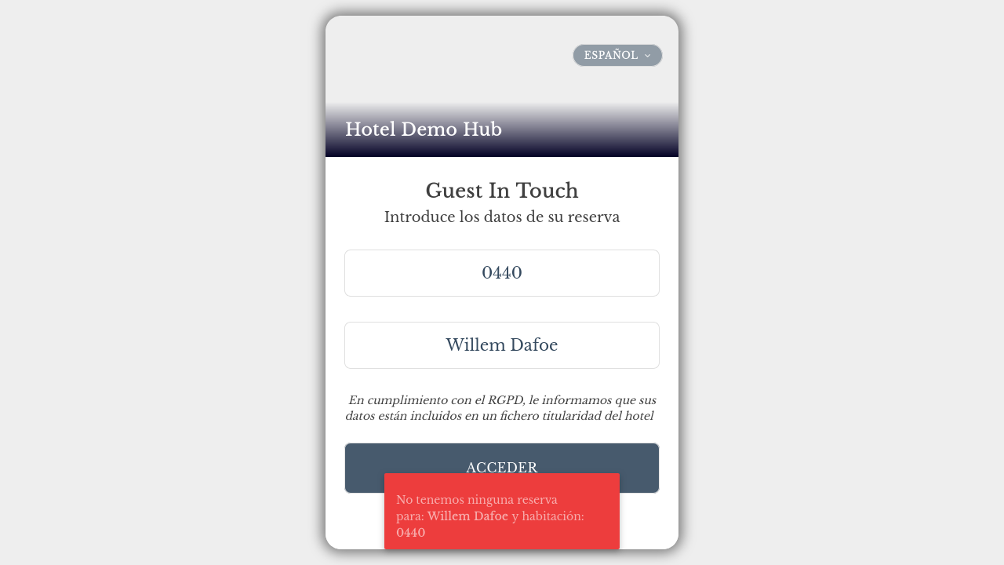
HubOS QA Engineer Homework XGA
22 dic 2025
should login with correct room and surname (B)
const loginPage = new LoginPage(page);
await loginPage.loginWithFandbInputs(ROOM, CORRECT_LOGIN);
await expect(page).not.toHaveURL(url); // Assert that URL changes after successful login
await expect(loginPage.fandbForm).toContainText(ROOM);
await expect(loginPage.fandbForm).toContainText(CORRECT_LOGIN);
await expect(loginPage.hotelName).toContainText(DEMOHUB);
HubOS
Page 2

Slide 3
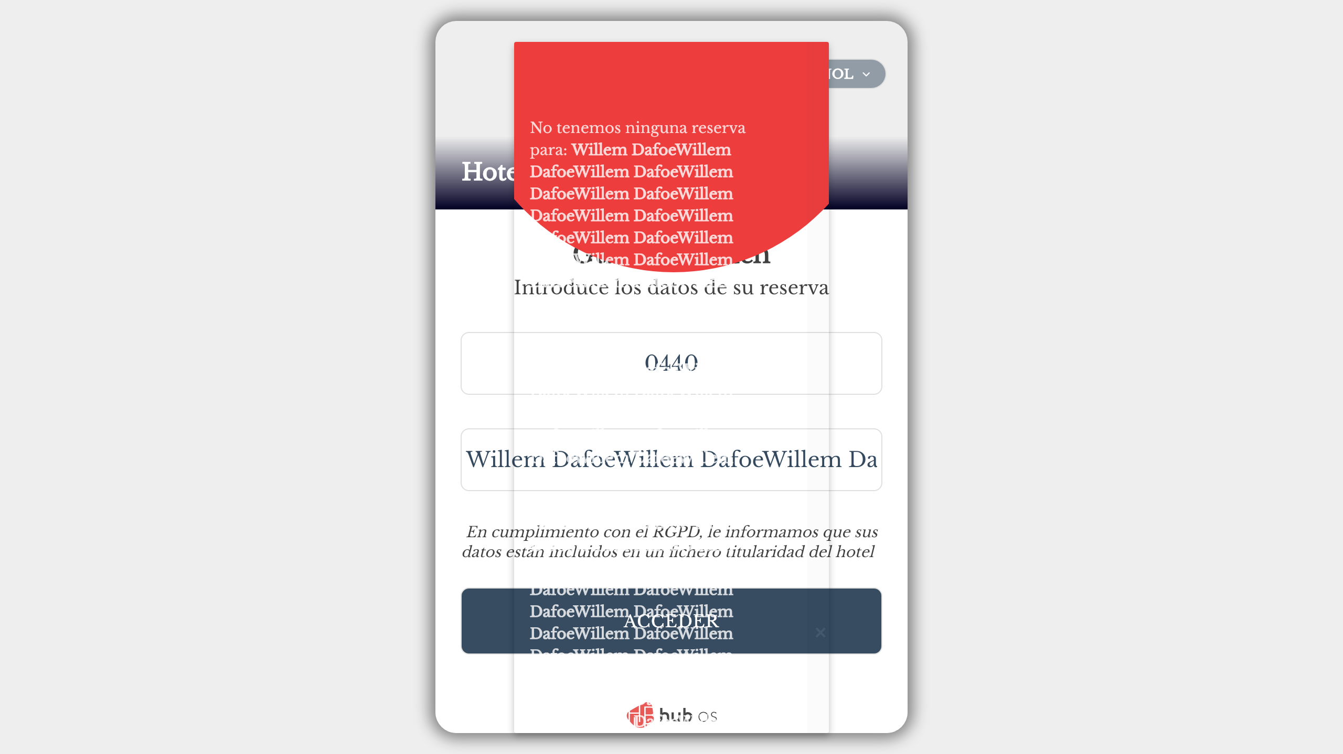

HubOS QA Engineer Homework XGA
22 dic 2025
should login and open chat (A)
const lp = new LoginPage(page);
await lp.fillRoom(ROOM);
await lp.fillName(CORRECT_LOGIN);
await lp.submitLogin(ROOM, true);
// Wait for login to take effect and assert logged-in state via POM helper
await lp.assertLoggedIn(ROOM, CORRECT_LOGIN, 15000);
// Open chat using page-object helper that returns a ChatPage
const chatPage = await lp.openChat(context);
await chatPage.assertAgentName("Alex Hub OS");
HubOS
Page 3

Slide 4
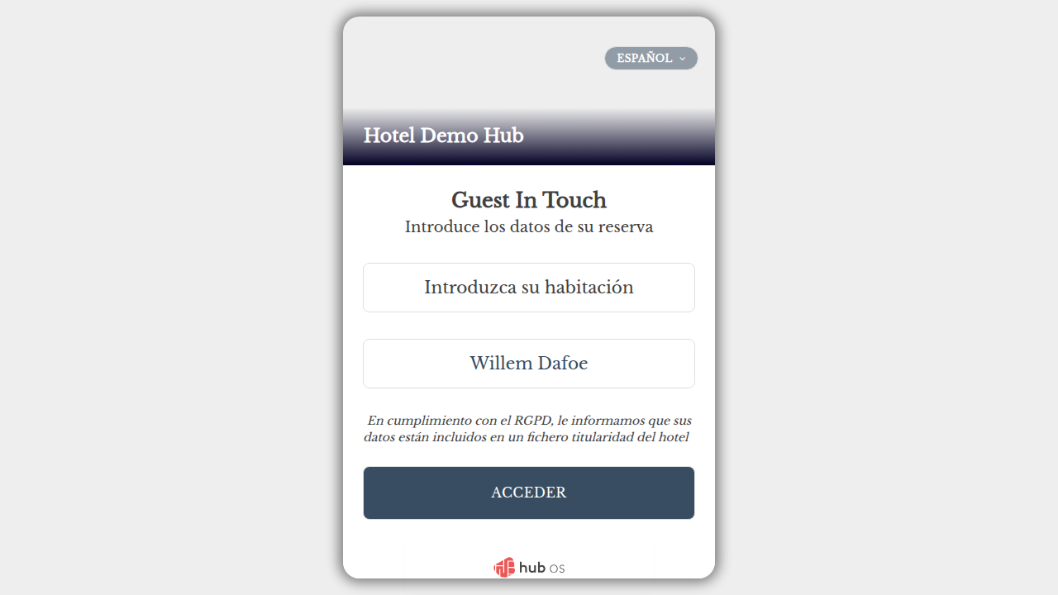
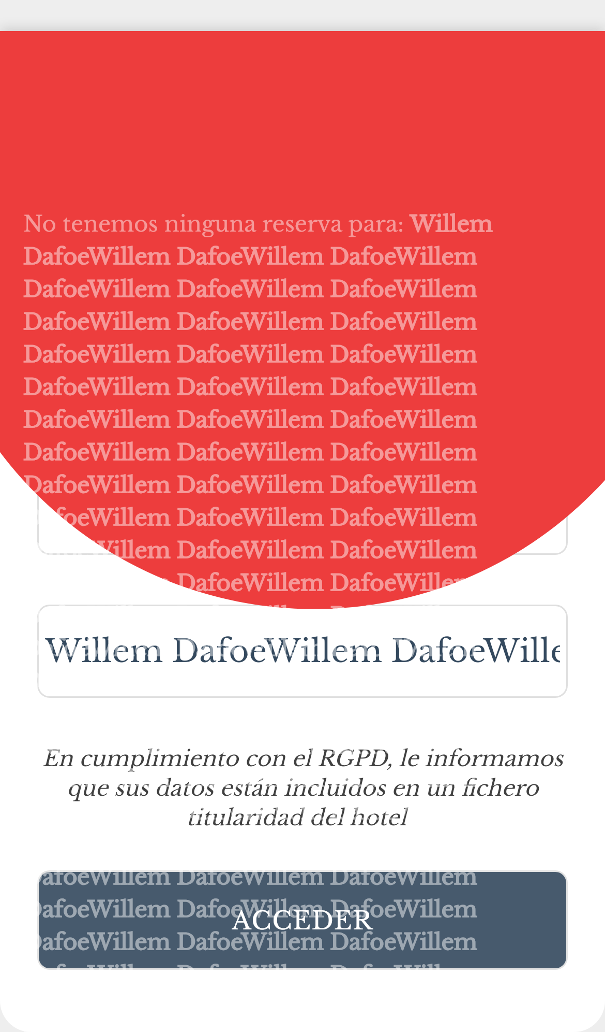
HubOS QA Engineer Homework XGA
22 dic 2025
should login and open chat (B)
const loginPage = new LoginPage(page);
await loginPage.loginWithFandbInputs(ROOM, CORRECT_LOGIN, true);
await loginPage.assertLoggedIn(ROOM, CORRECT_LOGIN, 15000);
const [chatPage] = await Promise.all([
context.waitForEvent("page"),
// For simplicity, we are testing with Spanish for now...
page.locator("div.gradient h2.title", { hasText: "Hablamos?" }).click()
]);
await chatPage.waitForLoadState("domcontentloaded");
await expect(chatPage.locator("h3._9vd5._9scb._9scr")).toContainText("Alex Hub OS");
HubOS
Page 4

Slide 5
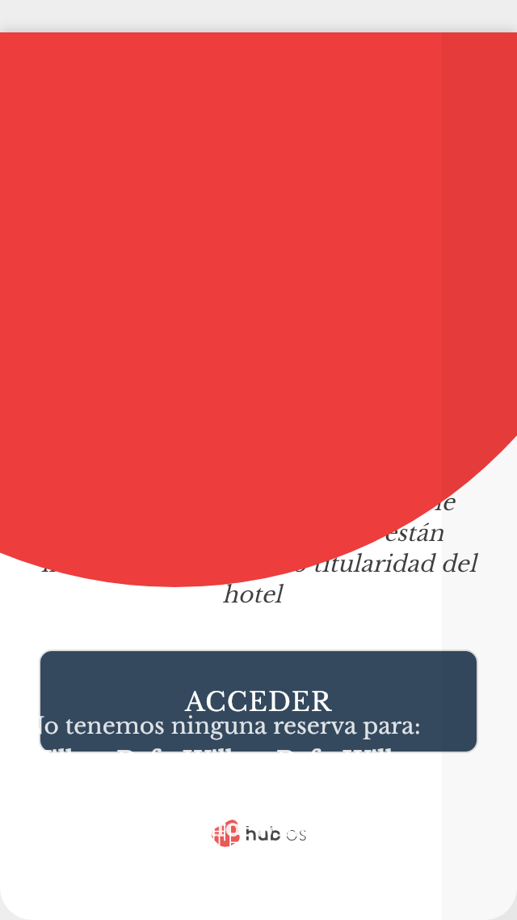
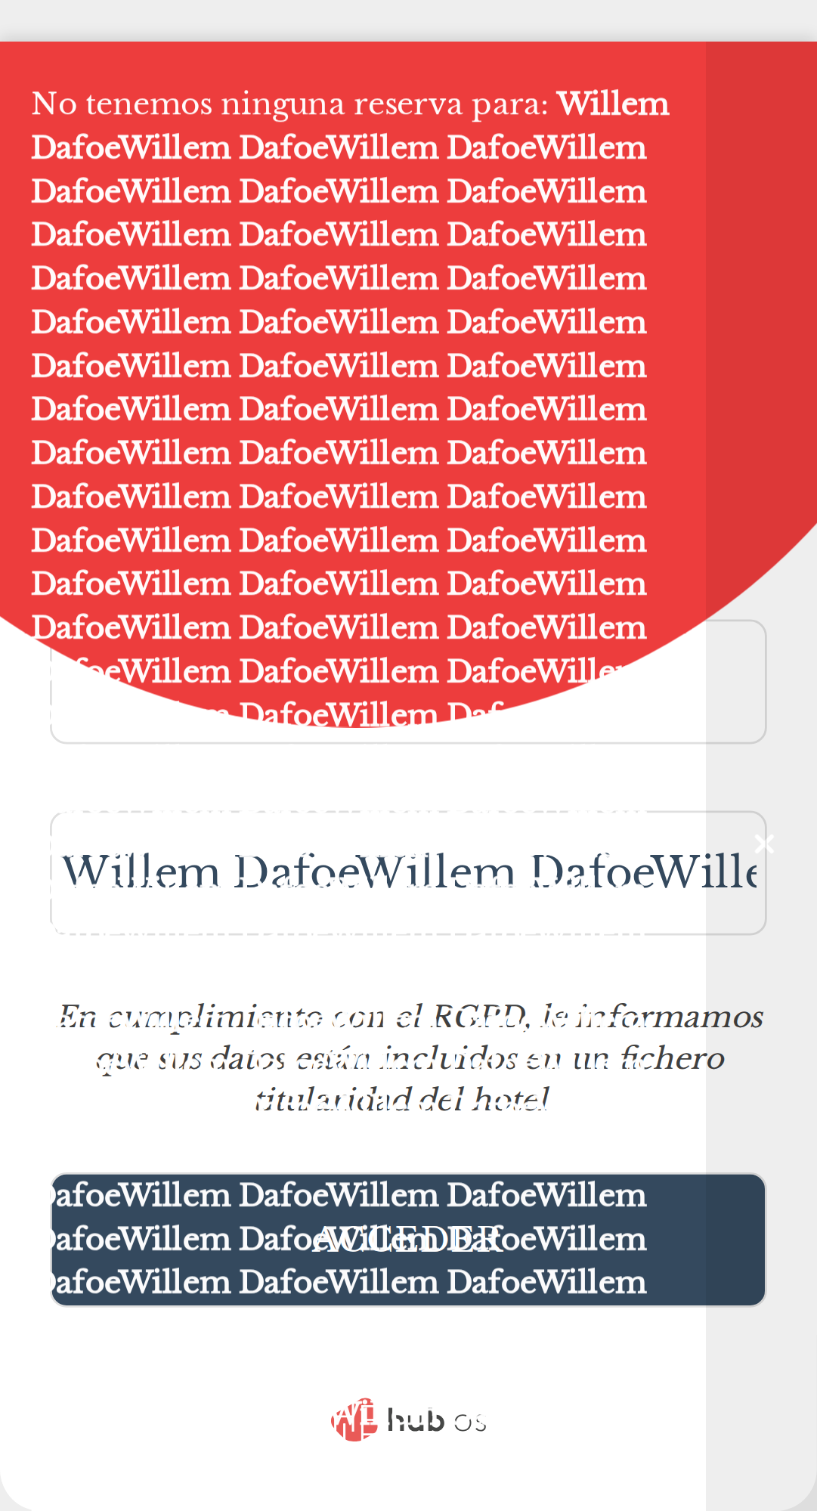
HubOS QA Engineer Homework XGA
22 dic 2025
should login with room number without leading zero (A)
const lp = new LoginPage(page);
await lp.fillRoom(ROOM2);
await lp.fillName(CORRECT_LOGIN);
await lp.submitLogin(ROOM2, true);
await expect(page).not.toHaveURL(url);
await lp.assertLoggedIn(ROOM2, CORRECT_LOGIN, 15000);
HubOS
Page 5

Slide 6

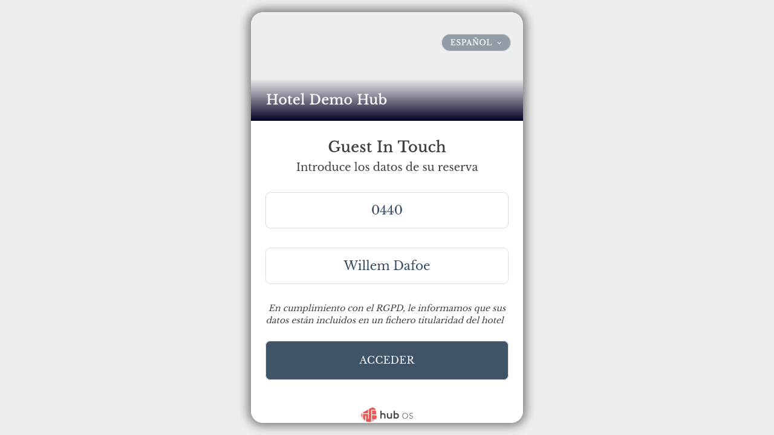
HubOS QA Engineer Homework XGA
22 dic 2025
should login with room number without leading zero (B)
const loginPage = new LoginPage(page);
await loginPage.loginWithFandbInputs(ROOM2, CORRECT_LOGIN, true);
await loginPage.assertLoggedIn(ROOM2, CORRECT_LOGIN, 15000);
HubOS
Page 6

Slide 7

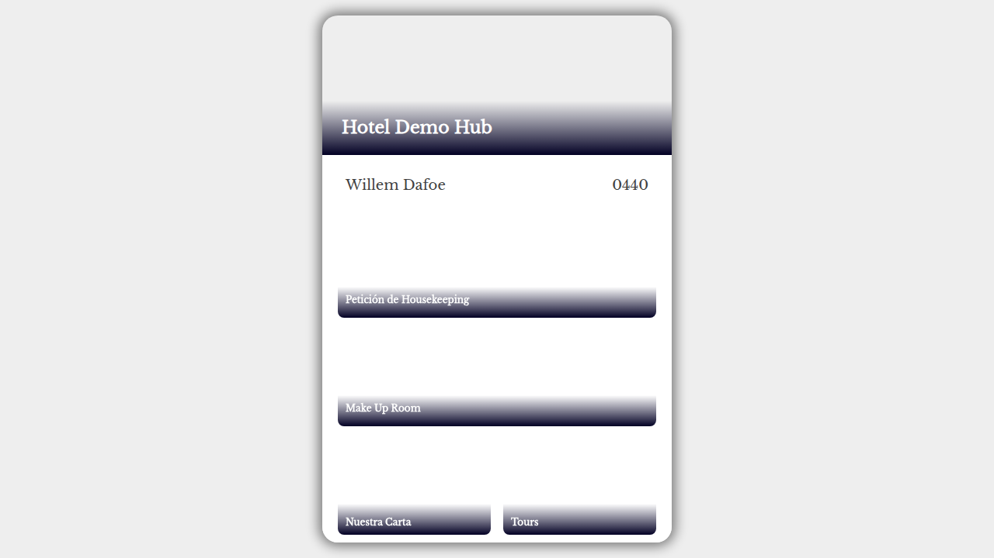
HubOS QA Engineer Homework XGA
22 dic 2025
should not login with incorrect room number (A)
const lp = new LoginPage(page);
await lp.fillRoom(WRONG_ROOM2);
await lp.fillName(CORRECT_LOGIN);
await lp.submitLogin(WRONG_ROOM2, false);
await expect(page).toHaveURL(url);
HubOS
Page 7

Slide 8

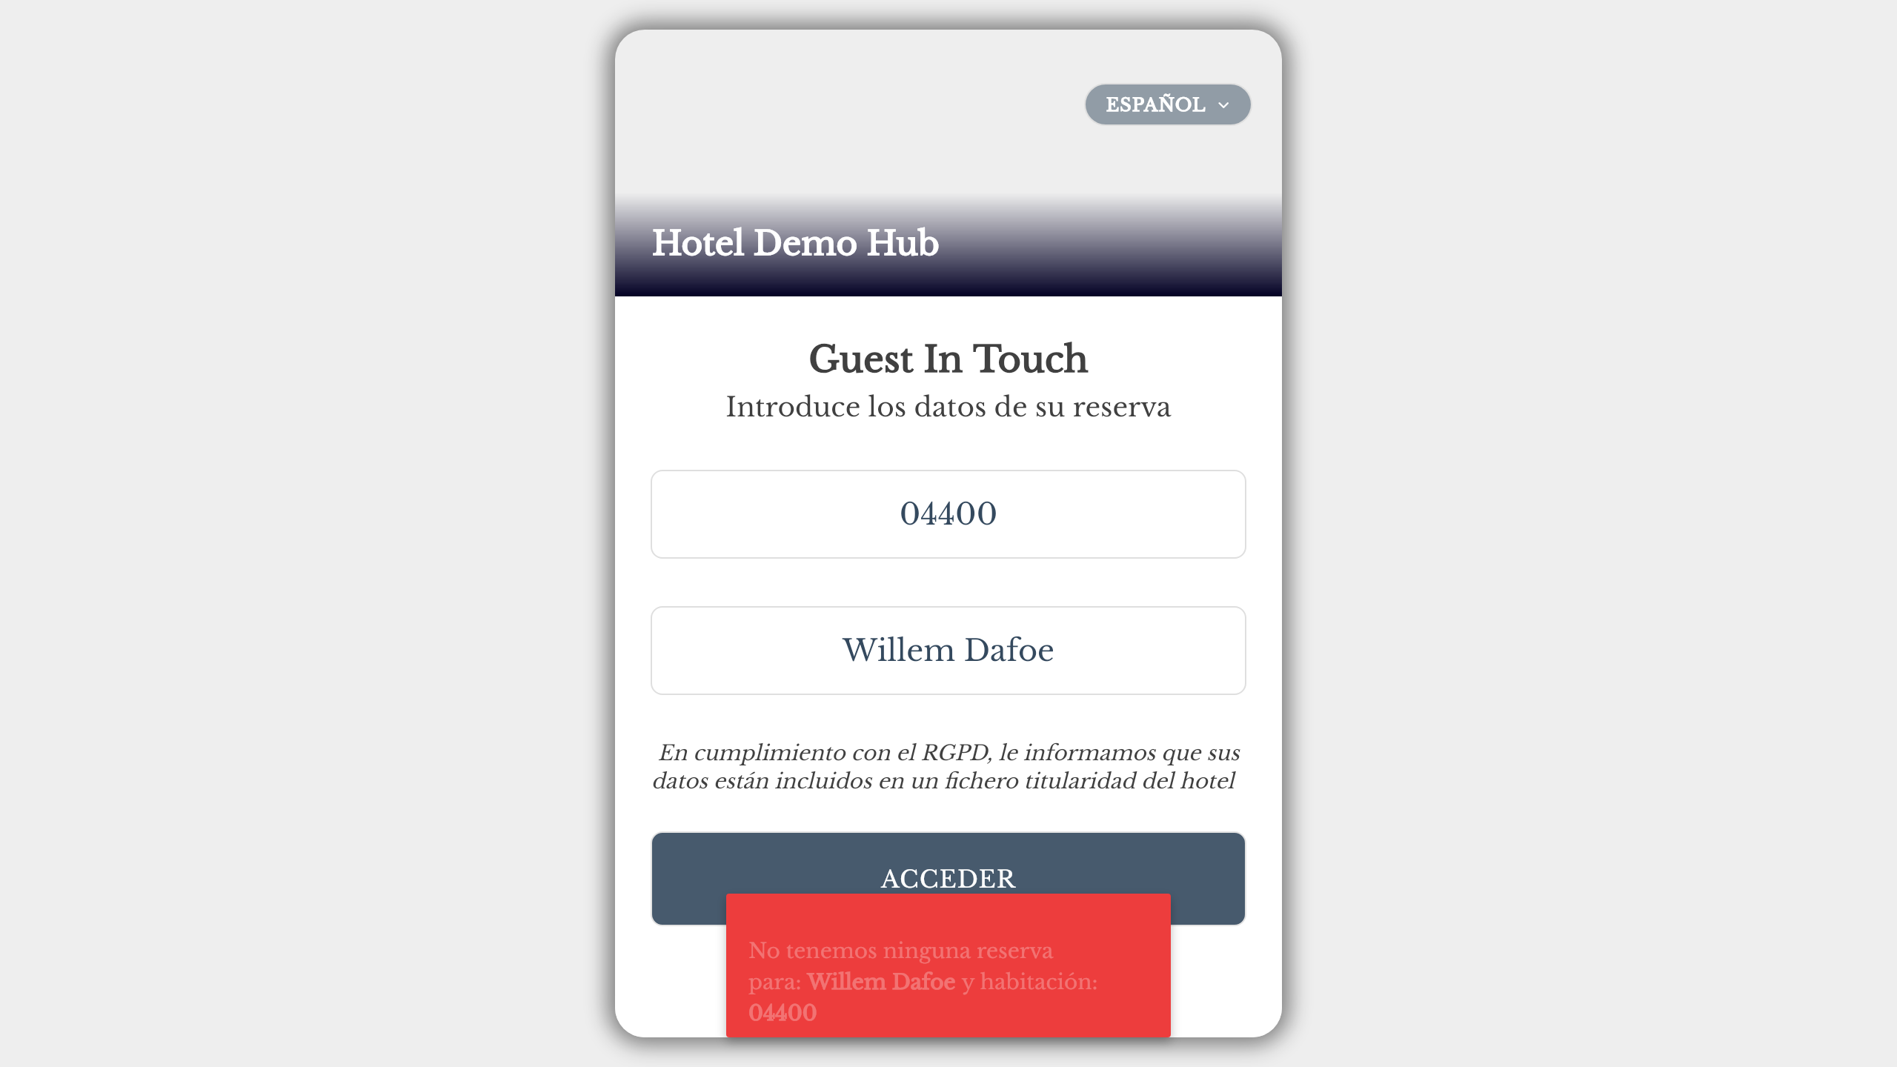
HubOS QA Engineer Homework XGA
22 dic 2025
should not login with incorrect room number (B)
const loginPage = new LoginPage(page);
await loginPage.loginWithFandbInputs(WRONG_ROOM2, CORRECT_LOGIN);
await expect(loginPage.notyfAnnouncer).toContainText(/no.*res.*:/i);
await expect(page).toHaveURL(url);
HubOS
Page 8

Slide 9


HubOS QA Engineer Homework XGA
22 dic 2025
should not login with incorrect surname (A)
const lp = new LoginPage(page);
await lp.fillRoom(ROOM);
await lp.fillName(INCORRECT_LOGIN2);
await lp.submitLogin(ROOM, false);
await expect(lp.notyfAnnouncer).toContainText(/no.*res.*:/i);
HubOS
Page 9

Slide 10


HubOS QA Engineer Homework XGA
22 dic 2025
should not login with incorrect surname (B)
const loginPage = new LoginPage(page);
await loginPage.loginWithFandbInputs(ROOM, INCORRECT_LOGIN);
await expect(loginPage.notyfAnnouncer).toContainText(/no.*res.*:/i);
HubOS
Page 10

Slide 11

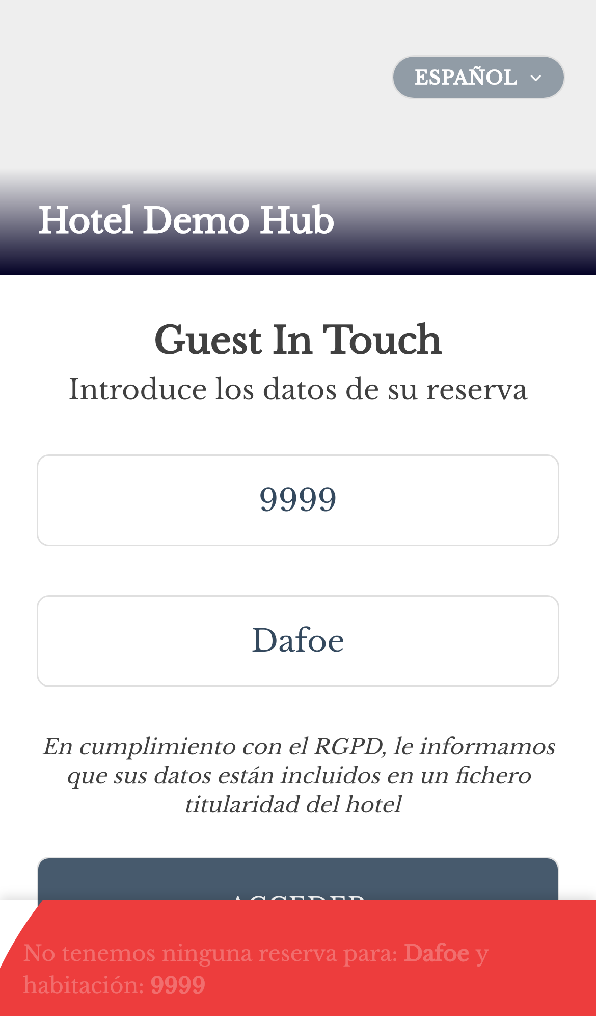
HubOS QA Engineer Homework XGA
22 dic 2025
should show error for empty fields (A)
const loginPage = new LoginPage(page);
await loginPage.loginButton.click();
await expect(page).toHaveURL(url); // Assert that URL remains unchanged if fields are empty
await expect(loginPage.notyfAnnouncer).toBeVisible();
await expect(loginPage.notyfAnnouncer).toContainText(/intro/i); // Assert error message: missing input
HubOS
Page 11

Slide 12
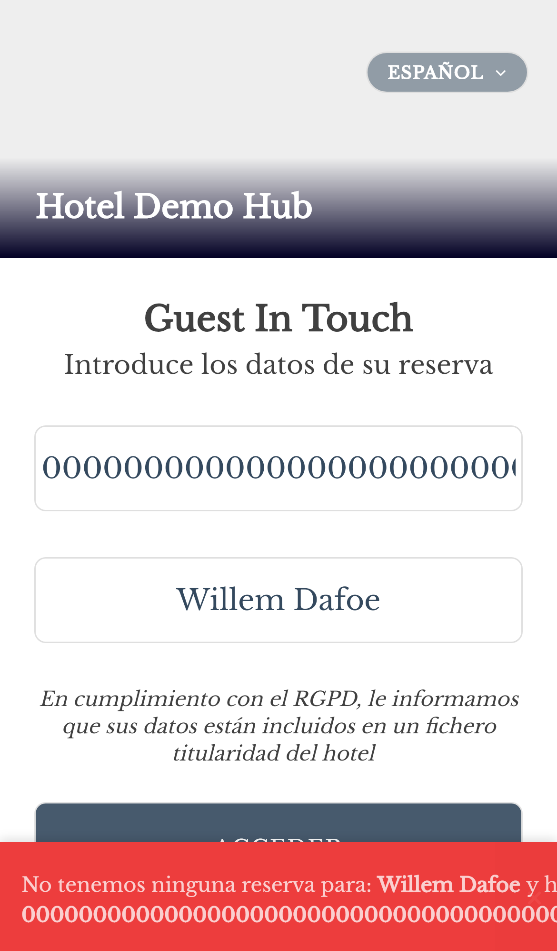
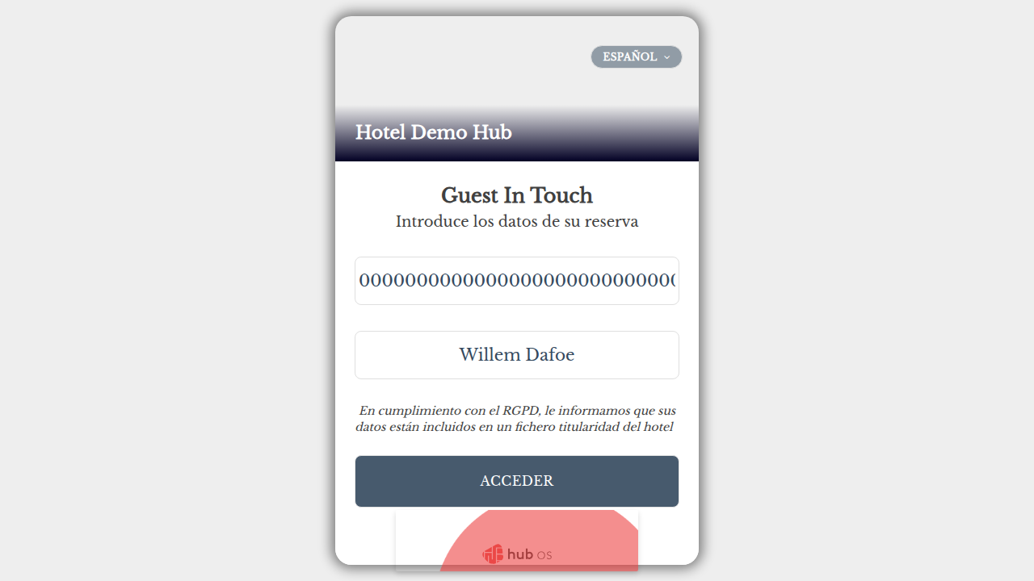
HubOS QA Engineer Homework XGA
22 dic 2025
should show error for empty fields (B)
const loginPage = new LoginPage(page);
await loginPage.loginButton.click();
await expect(loginPage.notyfAnnouncer).toContainText(/intro/i); // Assert error message: missing input
HubOS
Page 12

Slide 13


HubOS QA Engineer Homework XGA
22 dic 2025
should show error for special characters in room (A)
const lp = new LoginPage(page);
await lp.fillRoom("@#!");
await lp.fillName(CORRECT_LOGIN4);
await lp.submitLogin("@#!", false);
await expect(lp.notyfAnnouncer).toBeVisible();
HubOS
Page 13

Slide 14
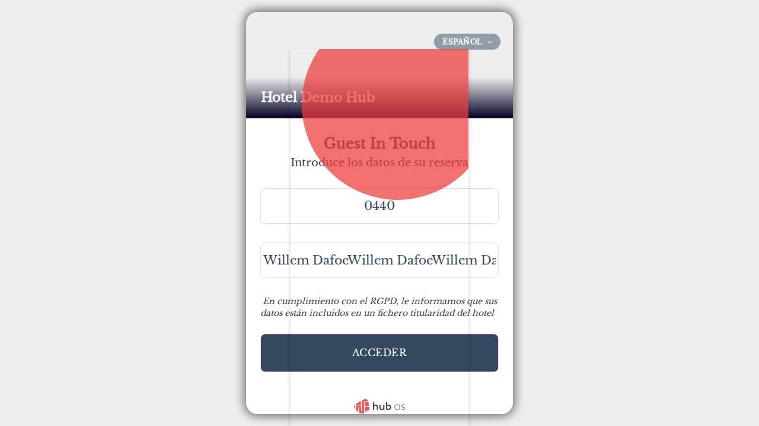
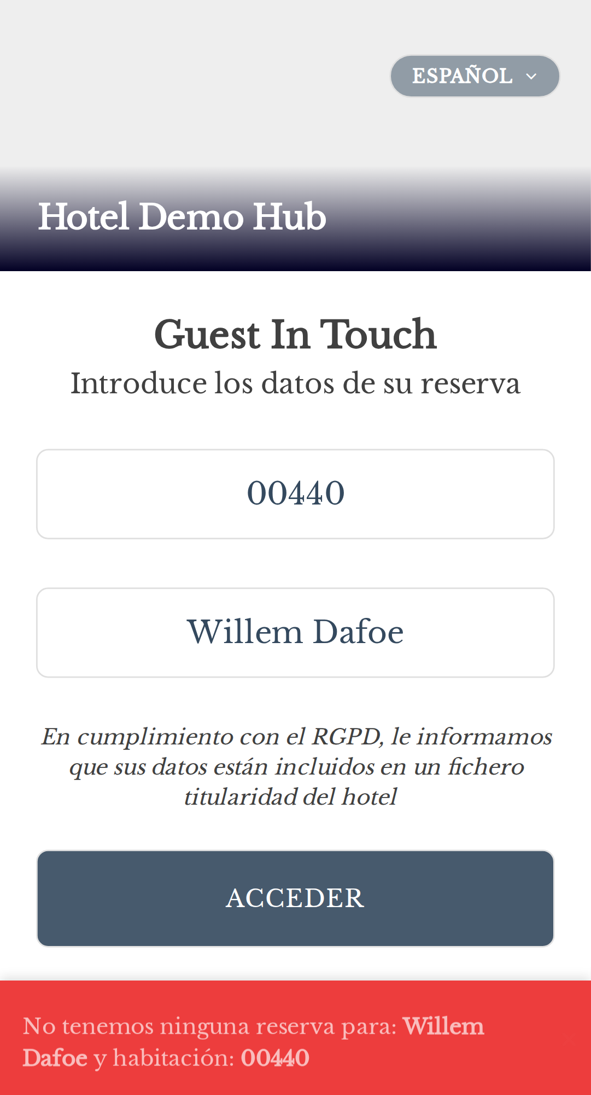
HubOS QA Engineer Homework XGA
22 dic 2025
should show error for special characters in room (B)
const loginPage = new LoginPage(page);
await loginPage.loginWithFandbInputs("@#!", CORRECT_LOGIN4);
await expect(loginPage.notyfAnnouncer).toContainText(/no.*res.*:/i);
HubOS
Page 14

Slide 15
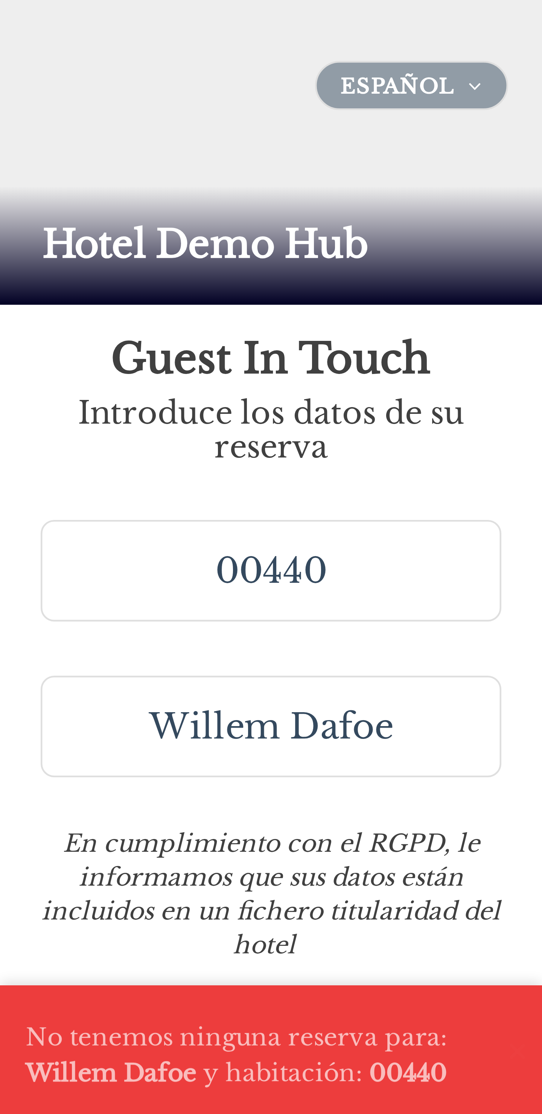

HubOS QA Engineer Homework XGA
22 dic 2025
should show error for special characters in surname (A)
const lp = new LoginPage(page);
await lp.fillRoom(ROOM);
await lp.fillName("D@foe");
await lp.submitLogin(ROOM, false);
await expect(lp.notyfAnnouncer).toBeVisible();
HubOS
Page 15

Slide 16
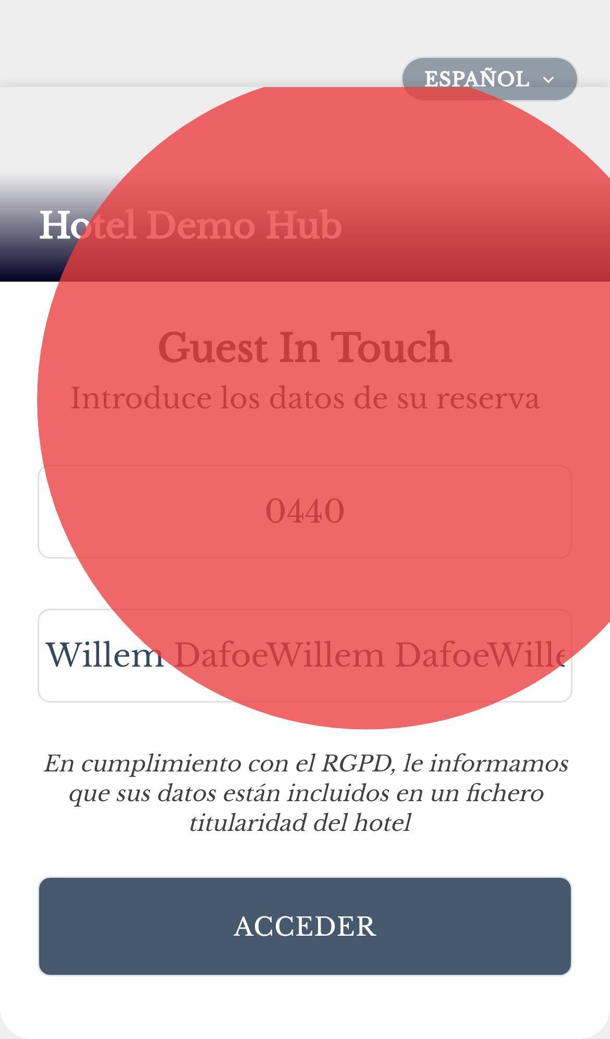
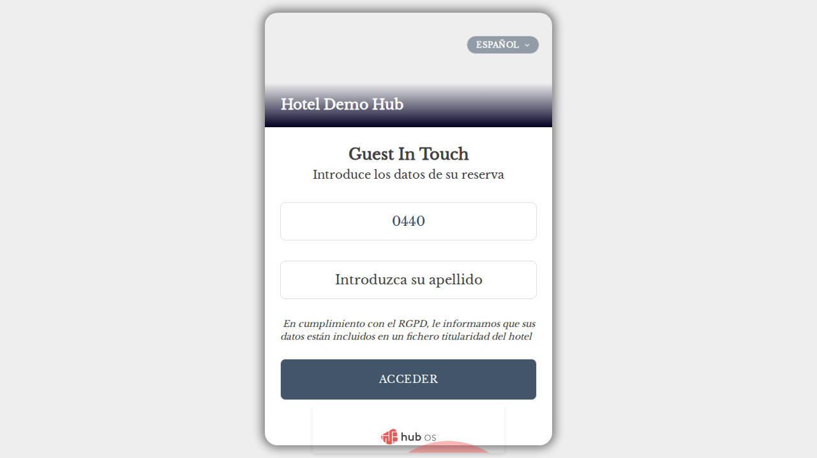
HubOS QA Engineer Homework XGA
22 dic 2025
should show error for special characters in surname (B)
const loginPage = new LoginPage(page);
await loginPage.loginWithFandbInputs(ROOM, "D@foe");
await expect(loginPage.notyfAnnouncer).toContainText(/no.*res.*:/i);
HubOS
Page 16

Slide 17


HubOS QA Engineer Homework XGA
22 dic 2025
should show error for very long room number (A)
const lp = new LoginPage(page);
await lp.fillRoom("0".repeat(50));
await lp.fillName(CORRECT_LOGIN4);
await lp.submitLogin("0".repeat(50), false);
await expect(page).toHaveURL(url); // Assert that URL remains unchanged for very long room number
await expect(lp.notyfAnnouncer).toBeVisible(); // Assert error message is visible for very long room number
await expect(lp.notyfAnnouncer).toContainText(/no.*res.*:/i); // Assert error message: no reservation for very long room number
HubOS
Page 17

Slide 18
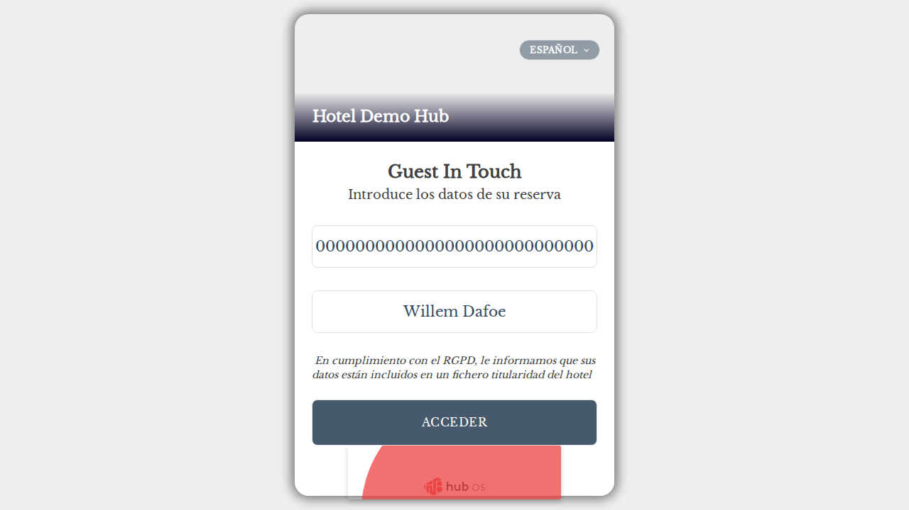

HubOS QA Engineer Homework XGA
22 dic 2025
should show error for very long room number (B)
const loginPage = new LoginPage(page);
await loginPage.loginWithFandbInputs("0".repeat(50), CORRECT_LOGIN4);
await expect(loginPage.notyfAnnouncer).toContainText(/no.*res.*:/i);
HubOS
Page 18

Slide 19
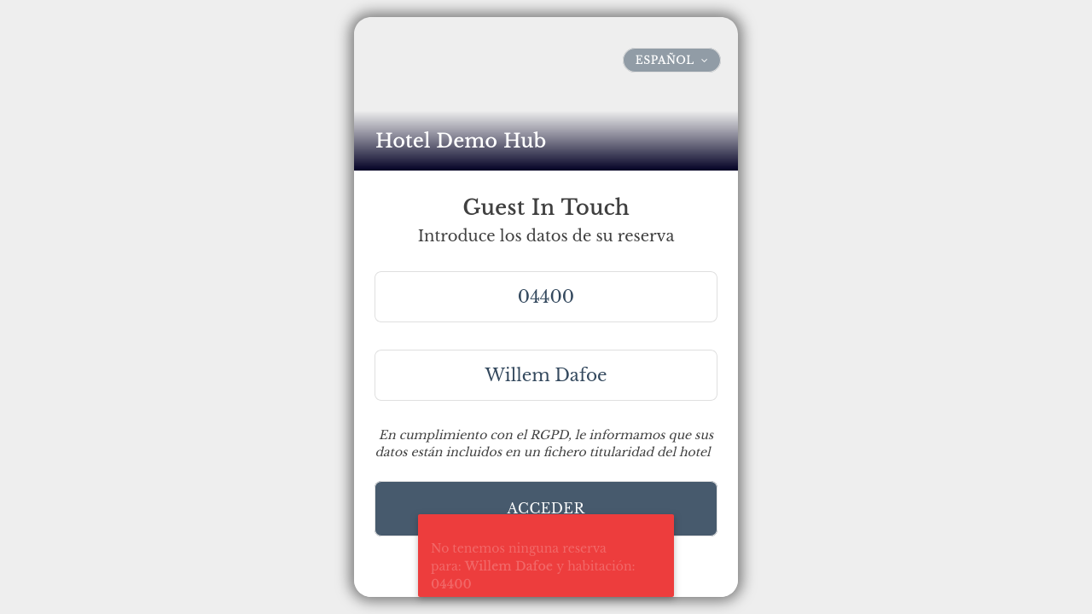

HubOS QA Engineer Homework XGA
22 dic 2025
should show error for very long room number (A) [POM]
const lp = new LoginPage(page);
await lp.fillRoom("0".repeat(50));
await lp.fillName(CORRECT_LOGIN4);
await lp.submitLogin("0".repeat(50), false);
await expect(page).toHaveURL(url);
await expect(lp.notyfAnnouncer).toBeVisible();
await expect(lp.notyfAnnouncer).toContainText(/no.*res.*:/i);
HubOS
Page 19

Slide 20
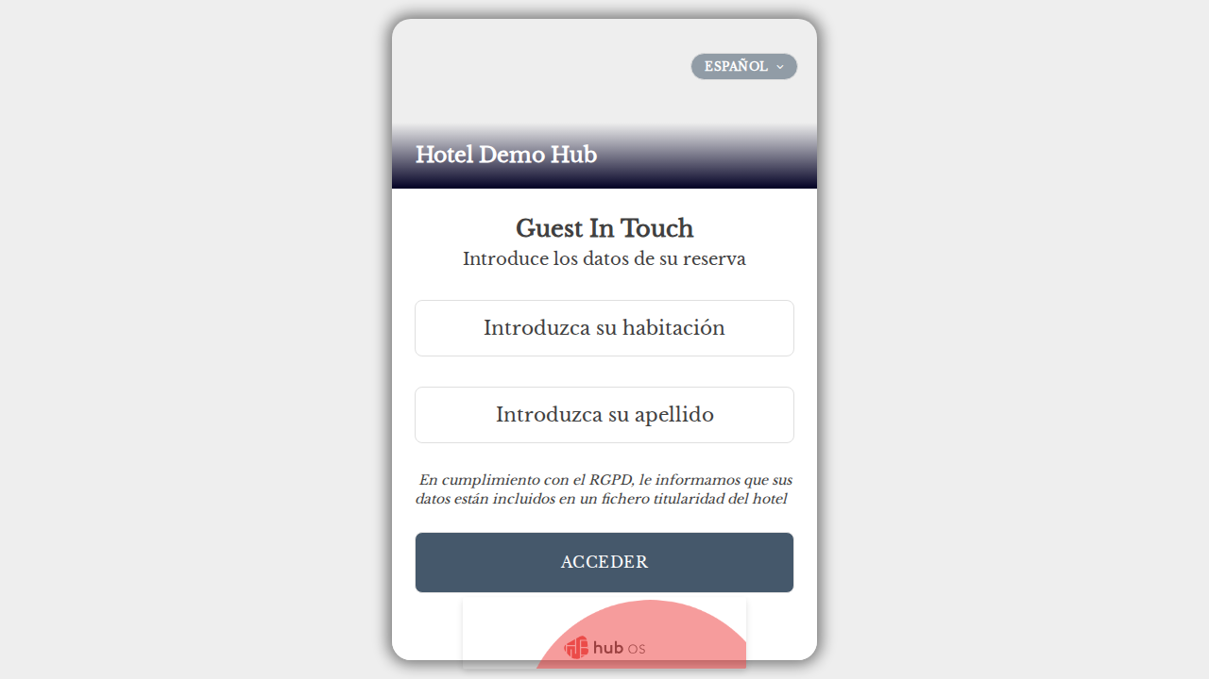

HubOS QA Engineer Homework XGA
22 dic 2025
should show error for very long room number (B) [POM]
const loginPage = new LoginPage(page);
await loginPage.loginWithFandbInputs("0".repeat(50), CORRECT_LOGIN4);
await expect(loginPage.notyfAnnouncer).toContainText(/no.*res.*:/i);
HubOS
Page 20

Slide 21

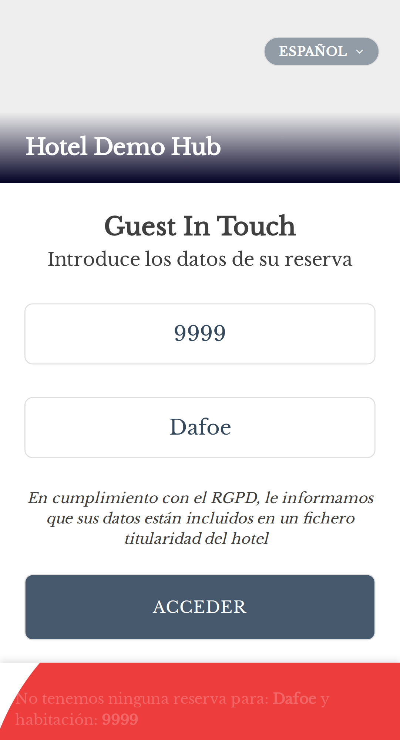
HubOS QA Engineer Homework XGA
22 dic 2025
should show error for very long surname (A)
const lp = new LoginPage(page);
const longName = (CORRECT_LOGIN4).repeat(100);
await lp.fillRoom(ROOM);
await lp.fillName(longName);
await lp.submitLogin(ROOM, false);
await expect(page).toHaveURL(url); // Assert that URL remains unchanged for very long surname
await expect(lp.notyfAnnouncer).toBeVisible(); // Assert error message is visible for very long surname
await expect(lp.notyfAnnouncer).toContainText(/no.*res.*:/i); // Assert error message: no reservation for very long surname
HubOS
Page 21

Slide 22

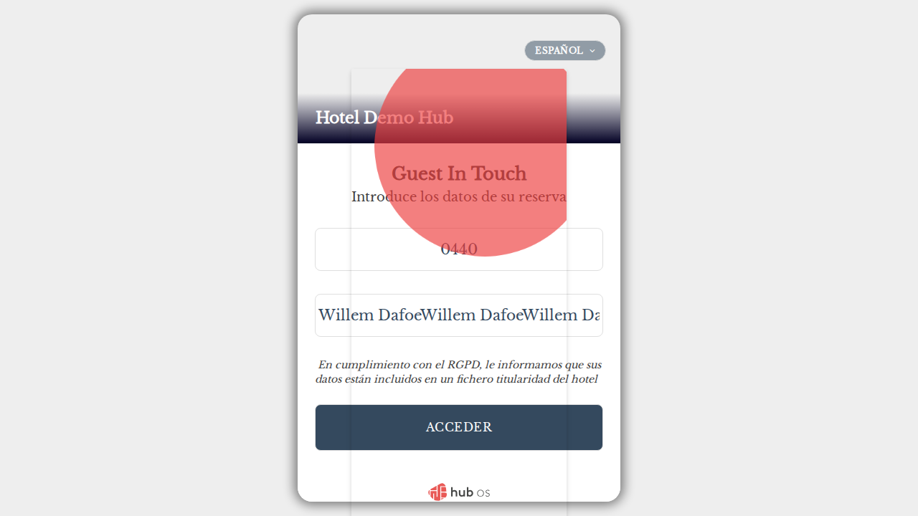
HubOS QA Engineer Homework XGA
22 dic 2025
should show error for very long surname (B)
const loginPage = new LoginPage(page);
const veryLong = (CORRECT_LOGIN4).repeat(1000);
await loginPage.loginWithFandbInputs(ROOM, veryLong);
await expect(page).toHaveURL(url);
await expect(loginPage.notyfAnnouncer).toBeVisible();
await expect(loginPage.notyfAnnouncer).toContainText(/no.*res.*:/i);
HubOS
Page 22

Slide 23
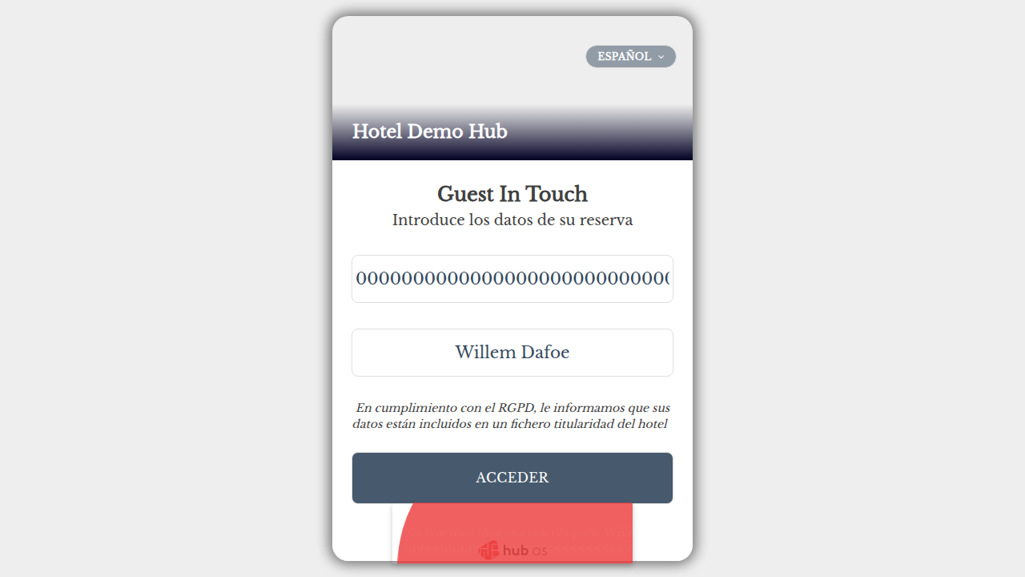

HubOS QA Engineer Homework XGA
22 dic 2025
should show error for very long surname (A) [POM]
const lp = new LoginPage(page);
const longName = (CORRECT_LOGIN4).repeat(100);
await lp.fillRoom(ROOM);
await lp.fillName(longName);
await lp.submitLogin(ROOM, false);
await expect(page).toHaveURL(url);
await expect(lp.notyfAnnouncer).toBeVisible();
await expect(lp.notyfAnnouncer).toContainText(/no.*res.*:/i);
HubOS
Page 23

Slide 24
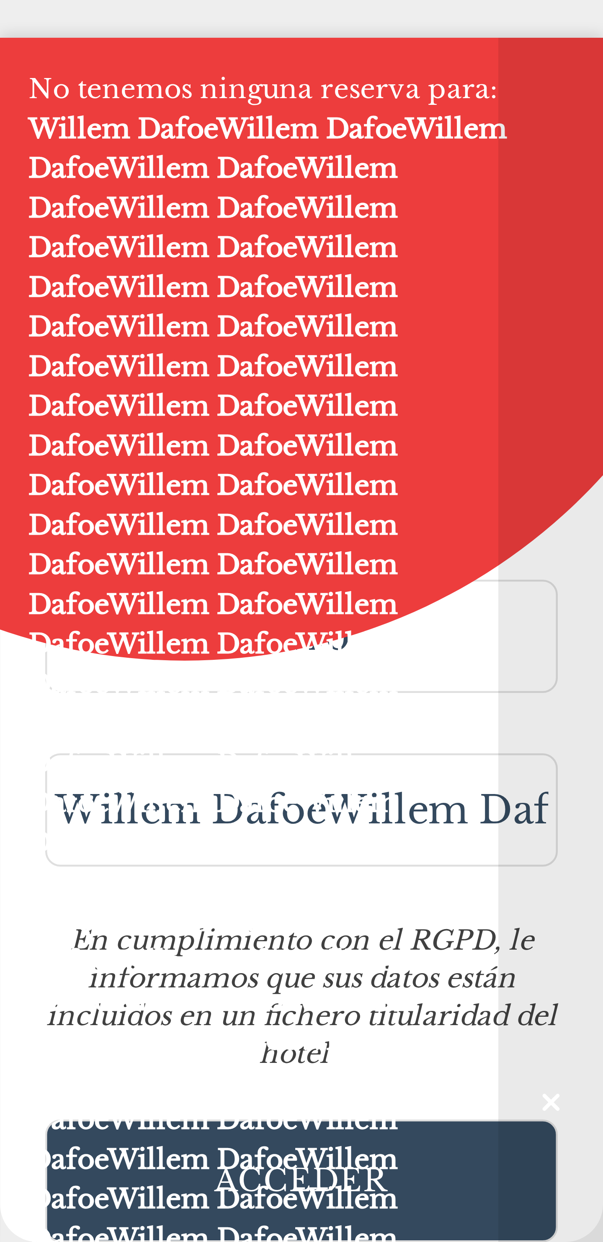
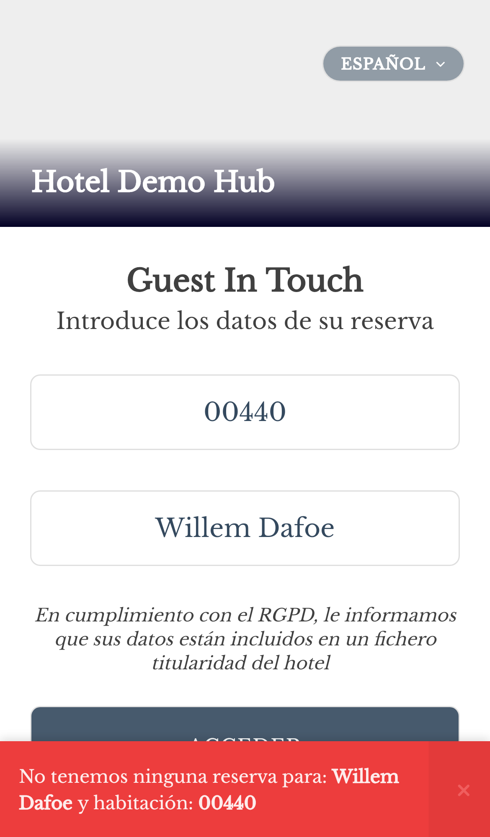
HubOS QA Engineer Homework XGA
22 dic 2025
should show error for very long surname (B) [POM]
const loginPage = new LoginPage(page);
const longName = (CORRECT_LOGIN4).repeat(1000);
await loginPage.loginWithFandbInputs(ROOM, longName);
await expect(page).toHaveURL(url);
await expect(loginPage.notyfAnnouncer).toBeVisible();
await expect(loginPage.notyfAnnouncer).toContainText(/no.*res.*:/i);
HubOS
Page 24

Slide 25


HubOS QA Engineer Homework XGA
22 dic 2025
should show error for whitespace in room and surname (A)
const lp = new LoginPage(page);
await lp.fillRoom(` ${ROOM} `);
await lp.fillName(` ${CORRECT_LOGIN4} `);
await lp.submitLogin(` ${ROOM} `, false);
await expect(lp.notyfAnnouncer).toBeVisible(); // Assert error message: no reservation for room and surname with whitespace
HubOS
Page 25

Slide 26
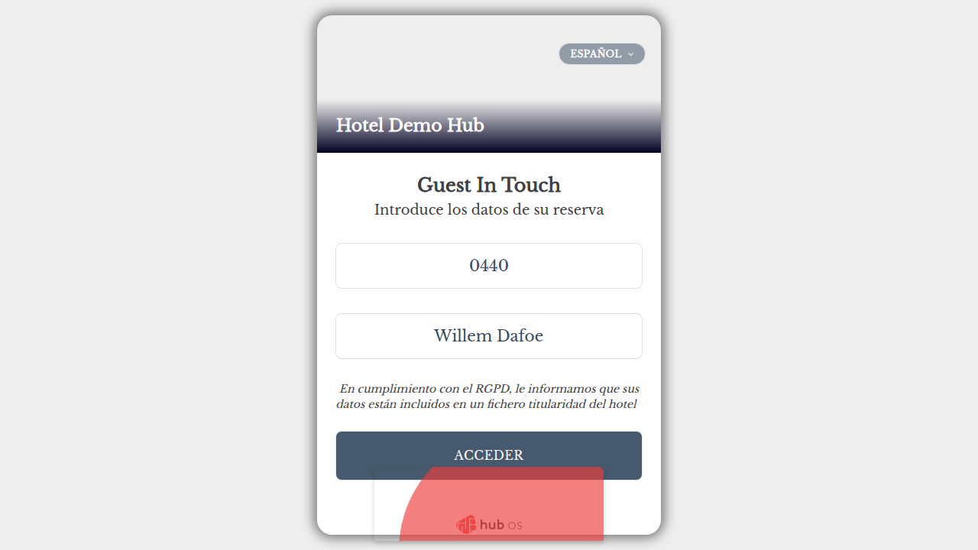
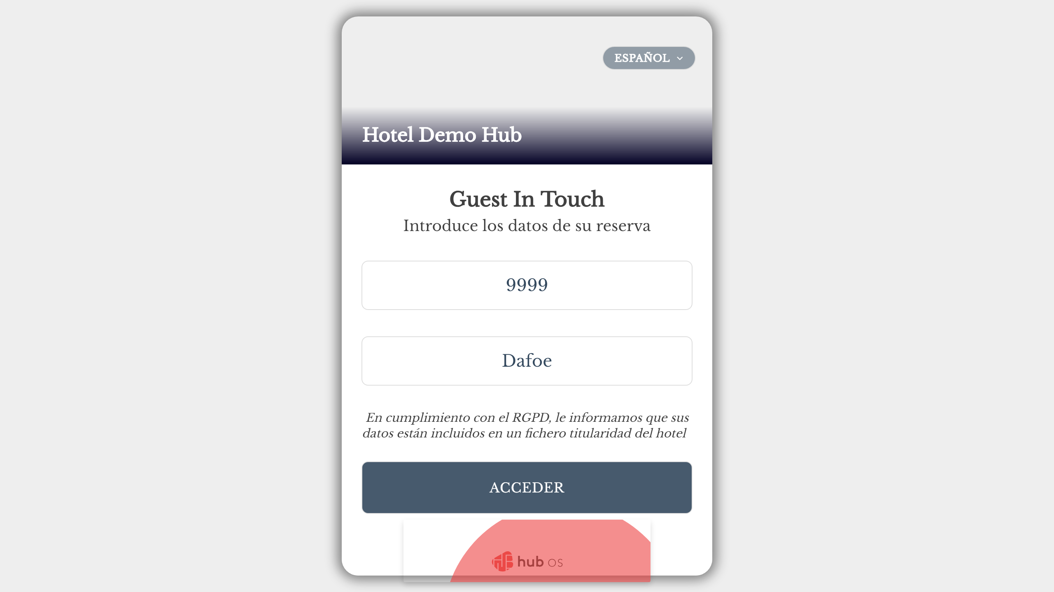
HubOS QA Engineer Homework XGA
22 dic 2025
should show error for whitespace in room and surname (B)
const loginPage = new LoginPage(page);
await loginPage.loginWithFandbInputs(` ${ROOM} `, ` ${CORRECT_LOGIN4} `);
await expect(loginPage.notyfAnnouncer).toContainText(/no.*res.*:/i);
HubOS
Page 26

Slide 27
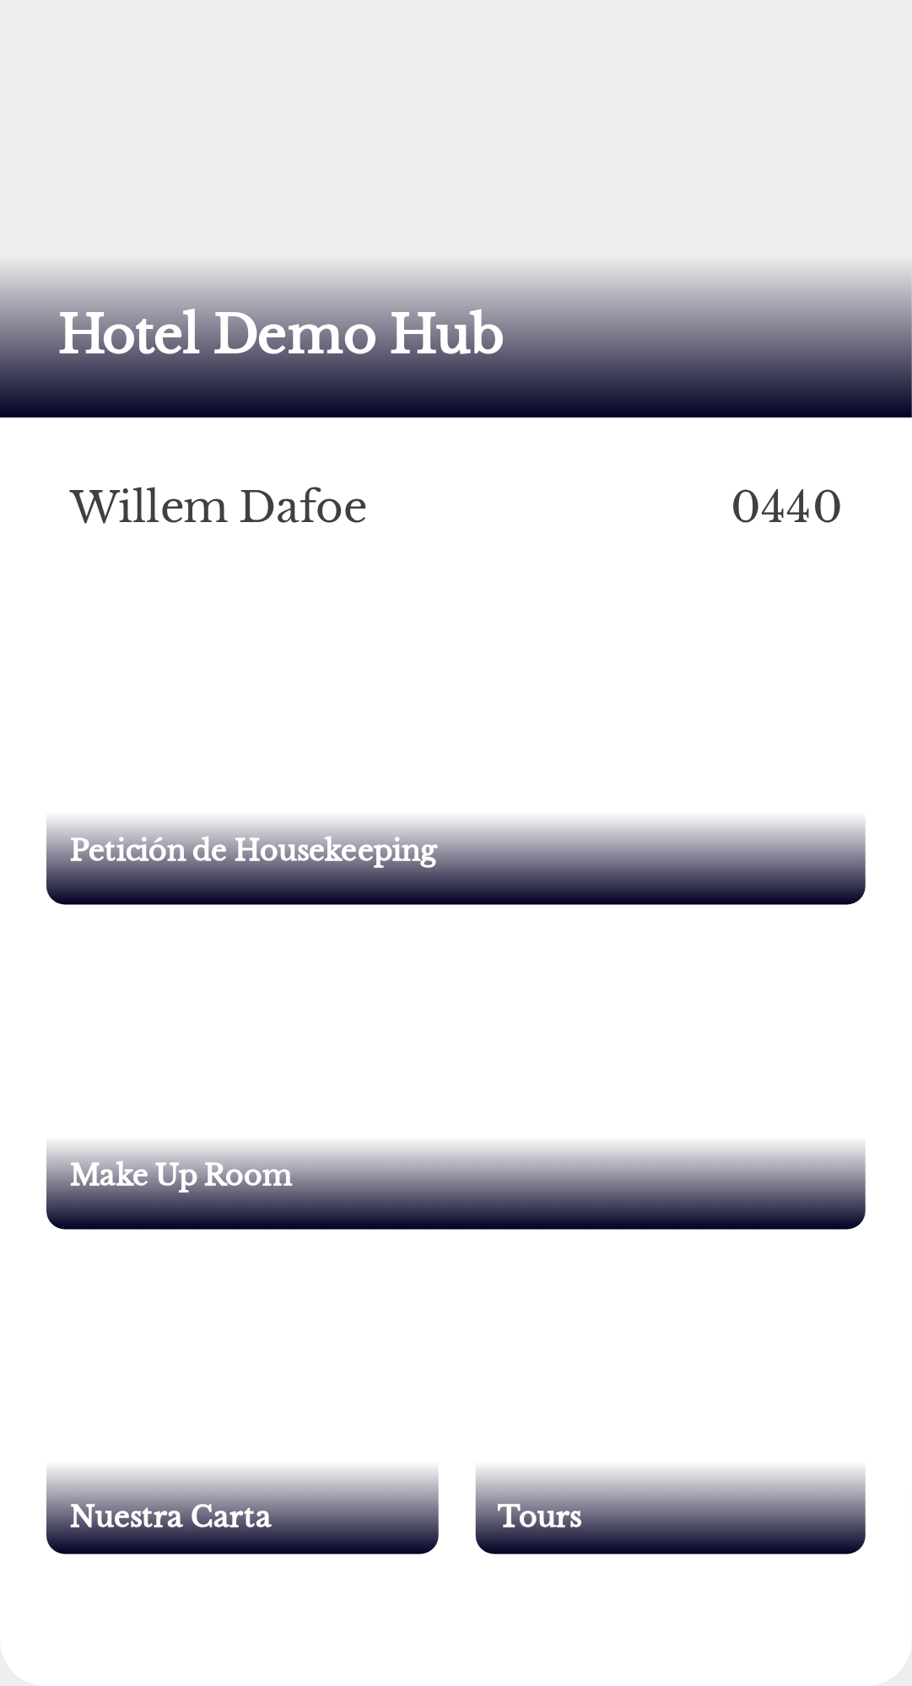
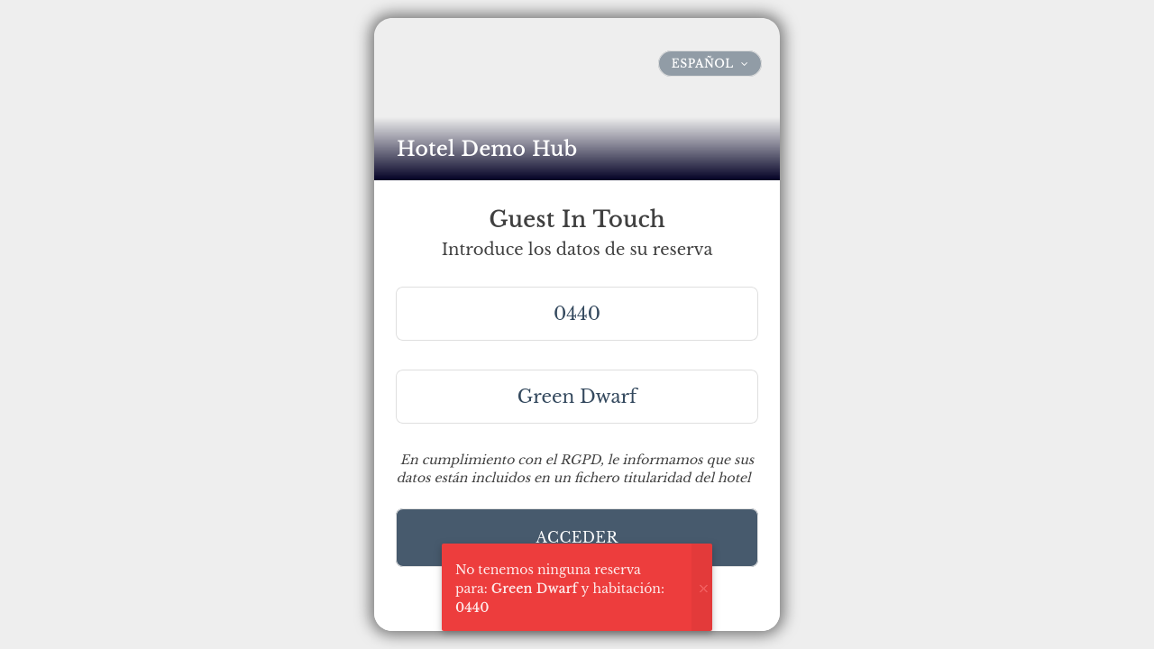
HubOS QA Engineer Homework XGA
22 dic 2025
should show error when only room is filled (A)
const loginPage = new LoginPage(page);
const lp = new LoginPage(page);
await lp.fillRoom(ROOM);
await lp.submitLogin(ROOM, false);
await expect(lp.notyfAnnouncer).toBeVisible(); // Assert error message: missing surname
HubOS
Page 27

Slide 28
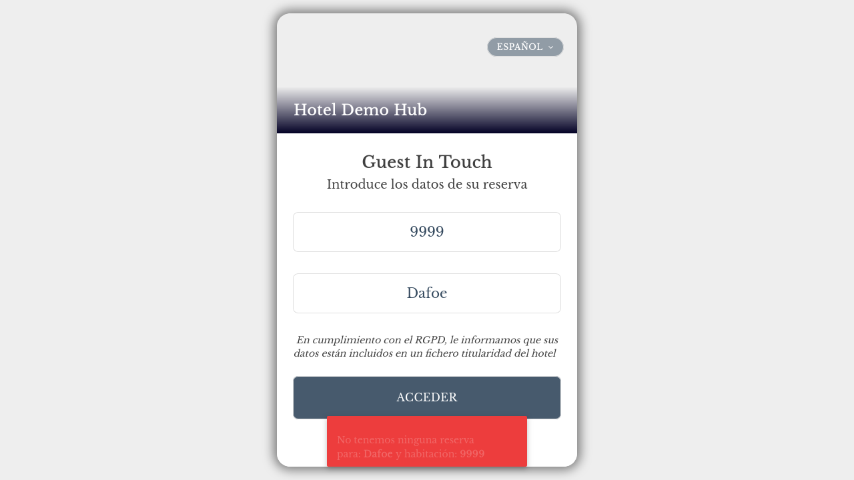
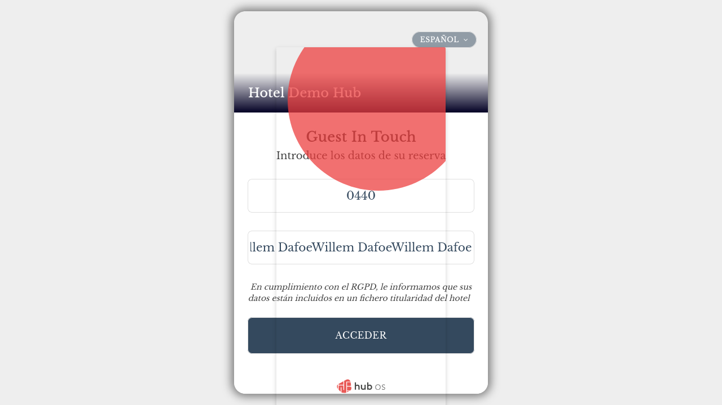
HubOS QA Engineer Homework XGA
22 dic 2025
should show error when only room is filled (B)
const loginPage = new LoginPage(page);
await loginPage.loginWithFandbInputs(ROOM, "");
await expect(loginPage.notyfAnnouncer).toContainText(/intro/i); // Assert error message: missing surname
HubOS
Page 28

Slide 29

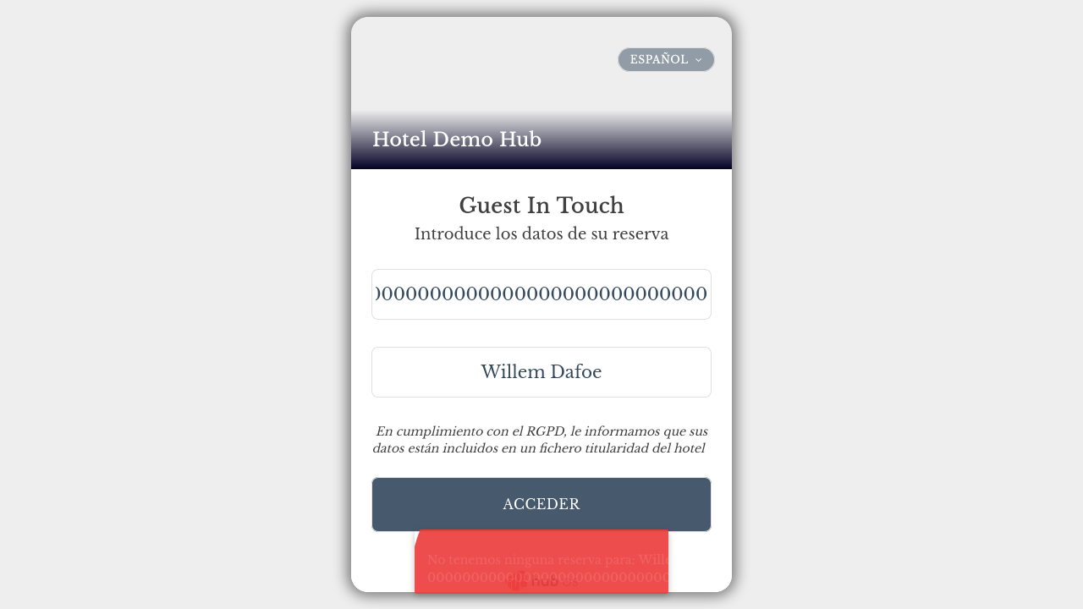
HubOS QA Engineer Homework XGA
22 dic 2025
should show error when only surname is filled (A)
const loginPage = new LoginPage(page);
const lp = new LoginPage(page);
await lp.fillName(CORRECT_LOGIN4);
await lp.submitLogin(undefined, false);
await expect(page).toHaveURL(url); // Assert that URL remains unchanged if only surname is filled
HubOS
Page 29

Slide 30
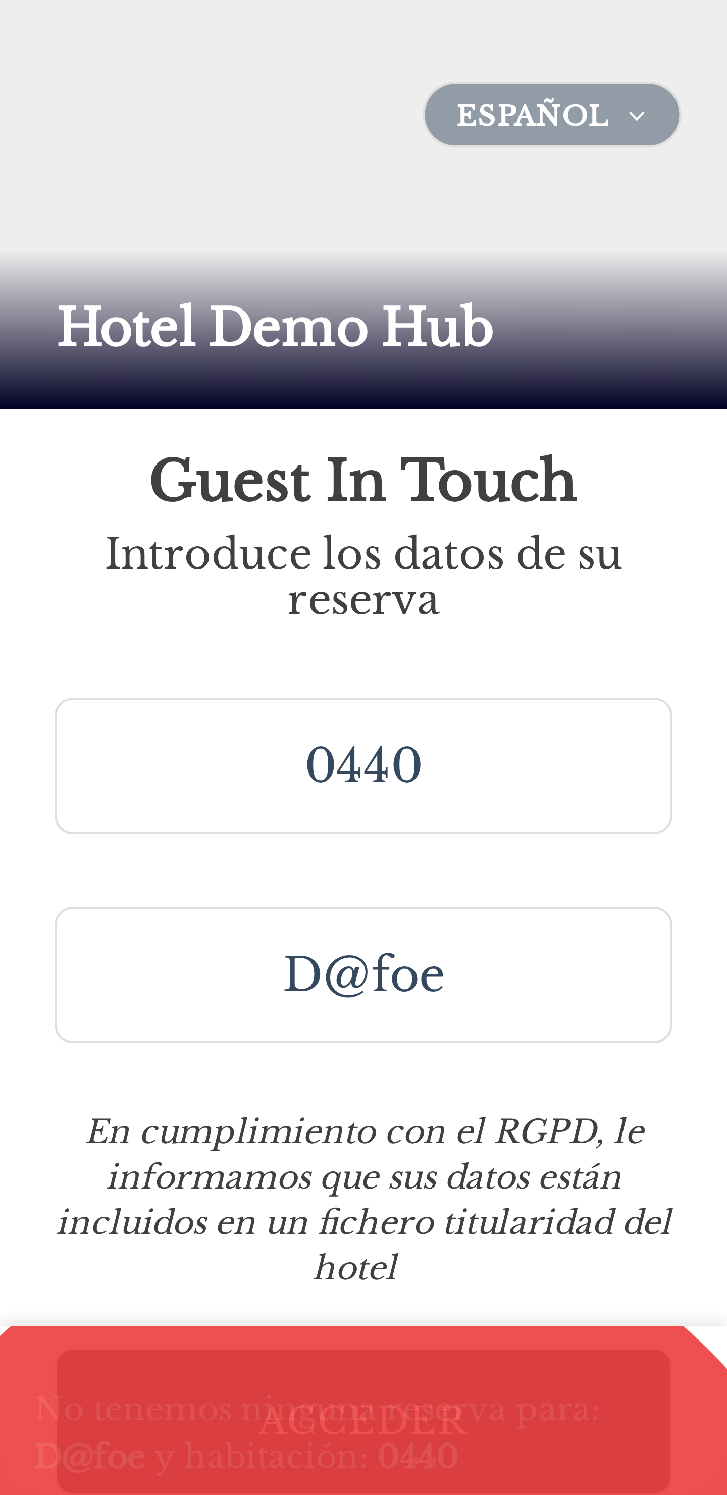
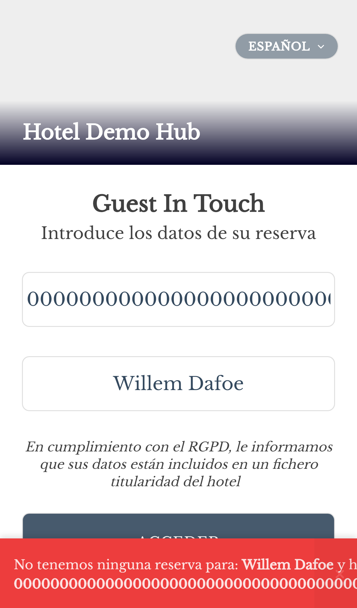
HubOS QA Engineer Homework XGA
22 dic 2025
should show error when only surname is filled (B)
const loginPage = new LoginPage(page);
await loginPage.loginWithFandbInputs("", CORRECT_LOGIN4);
await expect(loginPage.notyfAnnouncer).toBeVisible(); // Assert error message: missing room number
await expect(loginPage.notyfAnnouncer).toContainText(/intro/i); // Assert error message: missing room number
HubOS
Page 30

Slide 31
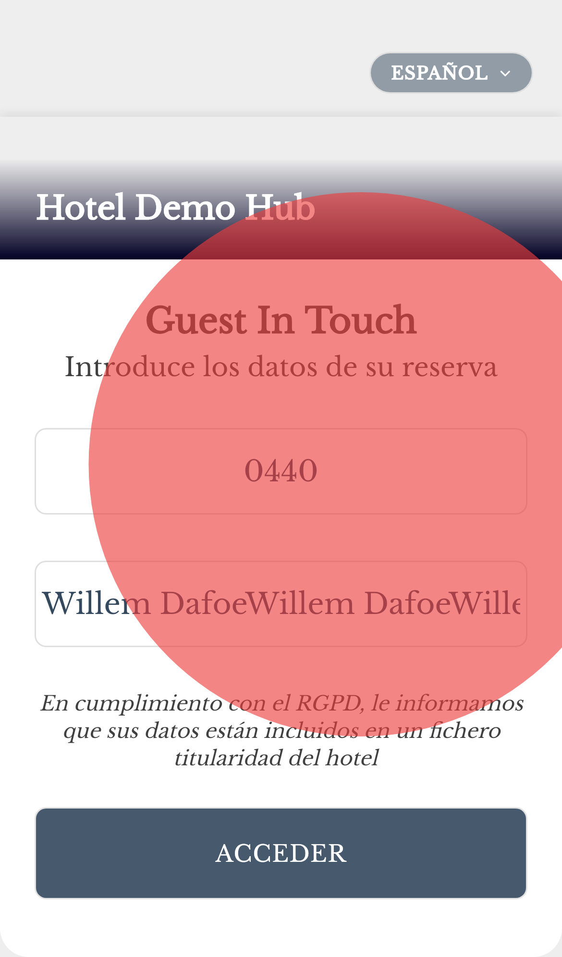
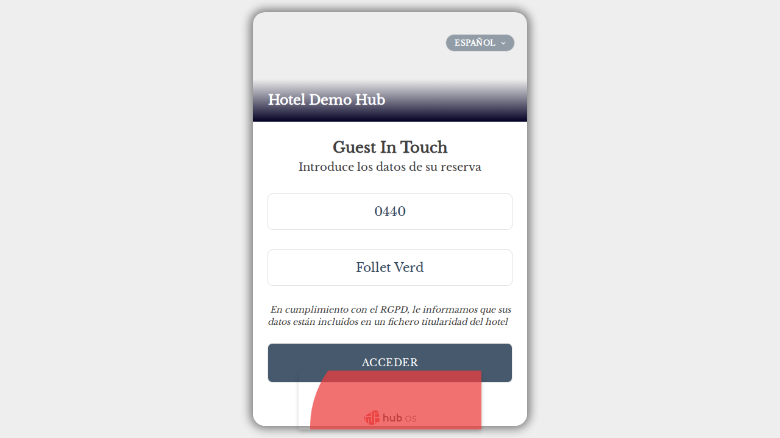
HubOS QA Engineer Homework XGA
22 dic 2025
should not login with extra trailing zero in room number (A)
const lp = new LoginPage(page);
await lp.fillRoom(ROOM + "0");
await lp.fillName(CORRECT_LOGIN4);
await lp.submitLogin(ROOM + "0", false);
await expect(lp.notyfAnnouncer).toContainText(/no.*res.*:/i); // Assert error message: no reservation for room with extra trailing zero
await expect(lp.notyfAnnouncer).toContainText(CORRECT_LOGIN4); // Assert error message: no reservation for room with extra trailing zero
await expect(lp.notyfAnnouncer).toContainText(ROOM + "0"); // Assert error message: no reservation for room with extra trailing zero
HubOS
Page 31

Slide 32

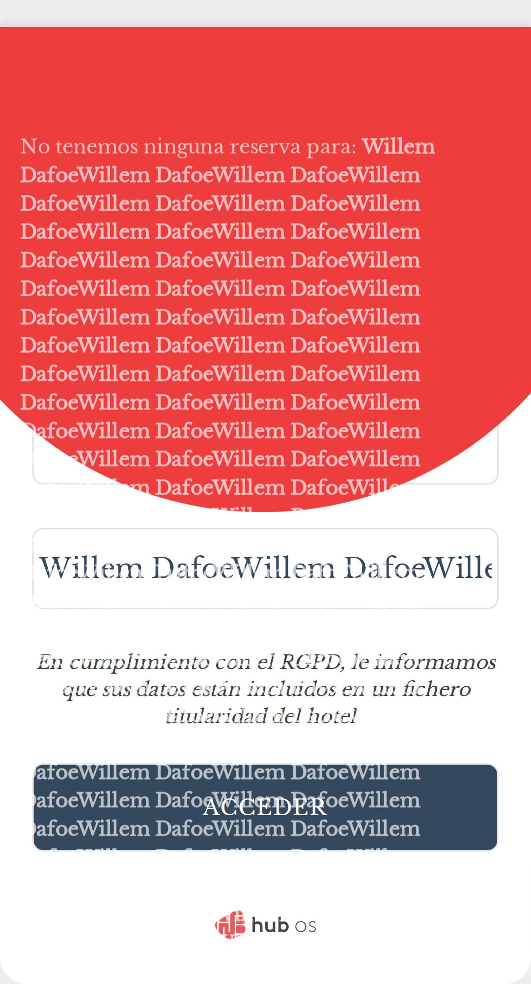
HubOS QA Engineer Homework XGA
22 dic 2025
should not login with extra trailing zero in room number (B)
const loginPage = new LoginPage(page);
await loginPage.loginWithFandbInputs(ROOM + "0", CORRECT_LOGIN4);
await expect(page).toHaveURL(url); // Assert that URL remains unchanged for room with extra trailing zero
await expect(loginPage.notyfAnnouncer).toContainText(/no.*res.*:/i); // Assert error message: no reservation for room with extra trailing zero
await expect(loginPage.notyfAnnouncer).toContainText(CORRECT_LOGIN4); // Assert error message: no reservation for room with extra trailing zero
await expect(loginPage.notyfAnnouncer).toContainText(ROOM + "0"); // Assert error message: no reservation for room with extra trailing zero
HubOS
Page 32

Slide 33
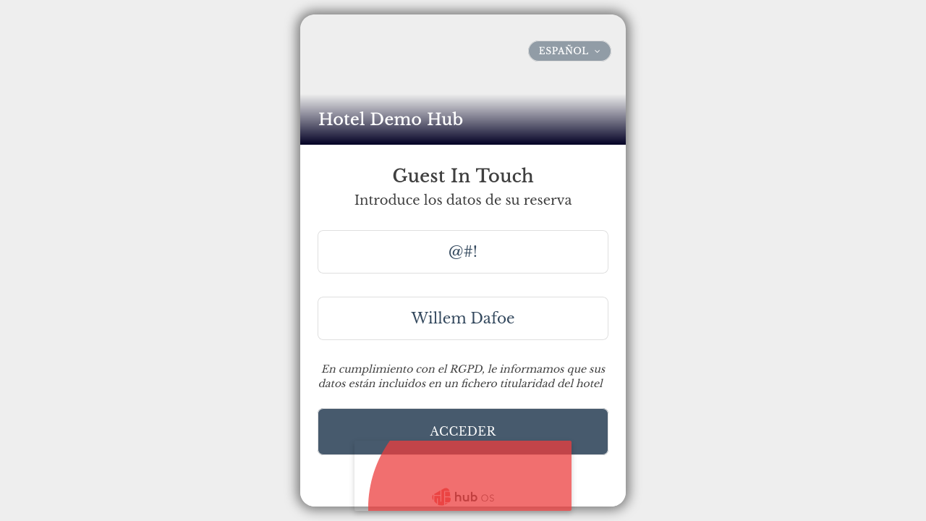
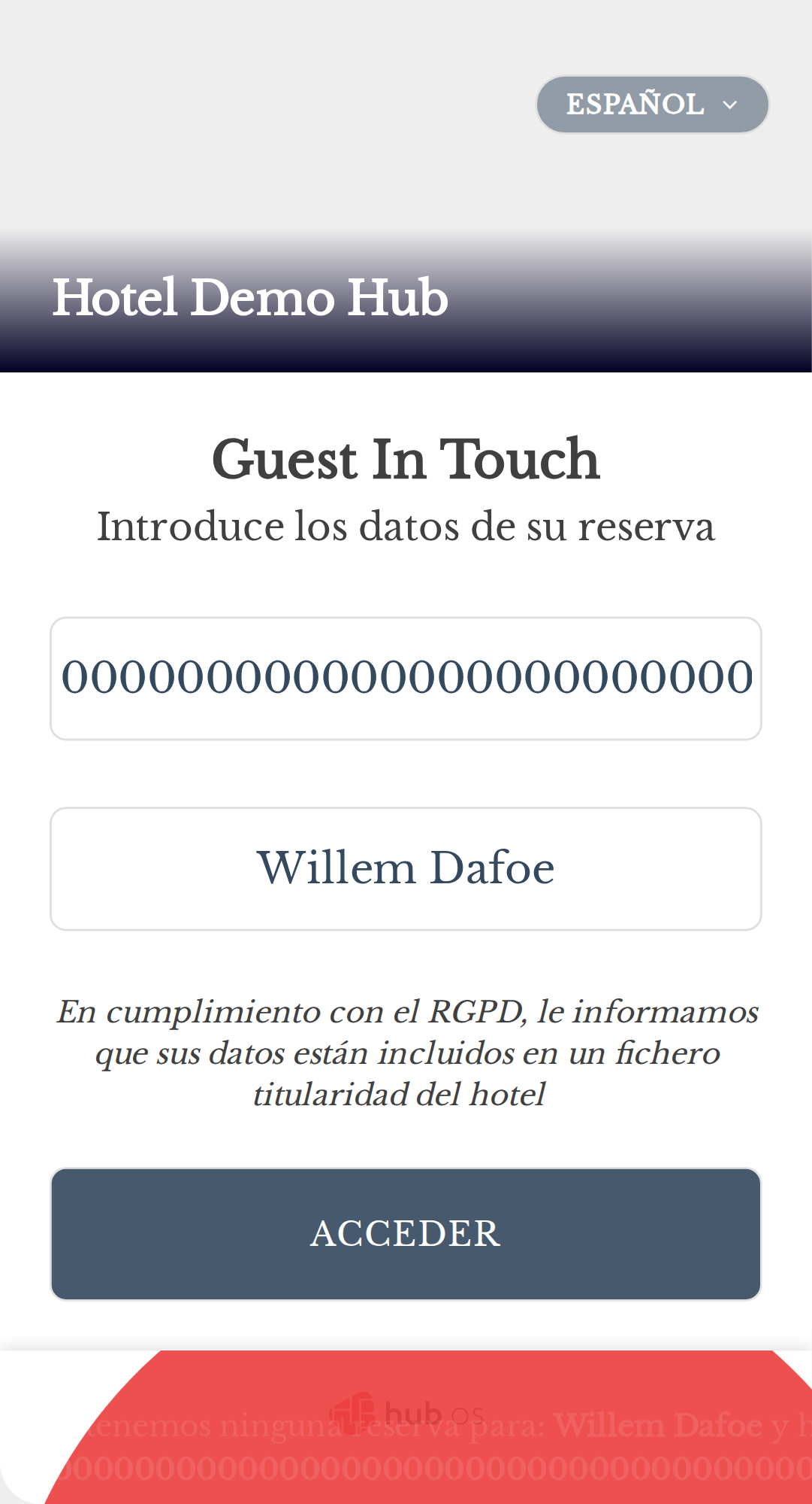
HubOS QA Engineer Homework XGA
22 dic 2025
should not login with double leading zero in room number (A)
const lp = new LoginPage(page);
await lp.fillRoom(WRONG_ROOM);
await lp.fillName(CORRECT_LOGIN4);
await lp.submitLogin(WRONG_ROOM, false);
await expect(page).toHaveURL(url); // Assert that URL remains unchanged for room with double leading zero
await expect(lp.notyfAnnouncer).toContainText(/no.*res.*:/i); // Assert error message: no reservation for room with double leading zero
await expect(lp.notyfAnnouncer).toContainText(CORRECT_LOGIN4); // Assert error message: no reservation for room with double leading zero
await expect(lp.notyfAnnouncer).toContainText(WRONG_ROOM); // Assert error message: no reservation for room with double leading zero
HubOS
Page 33

Slide 34
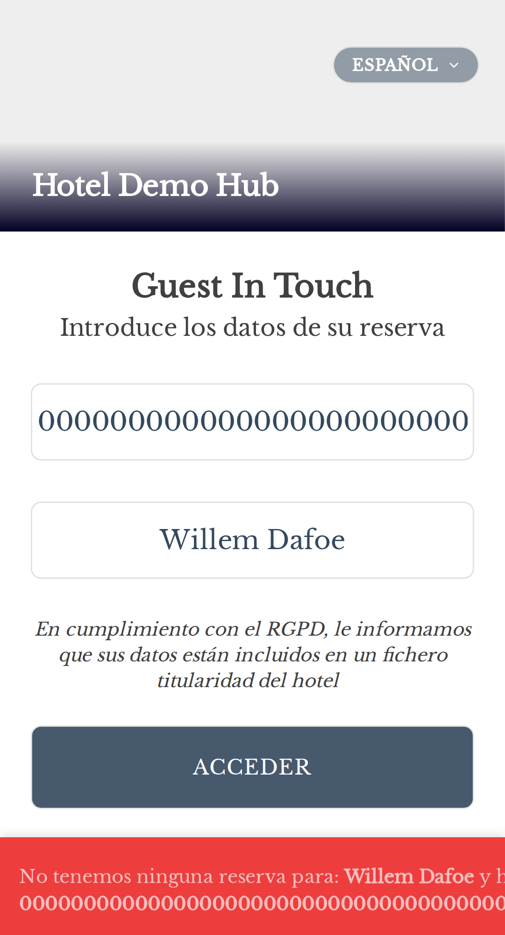
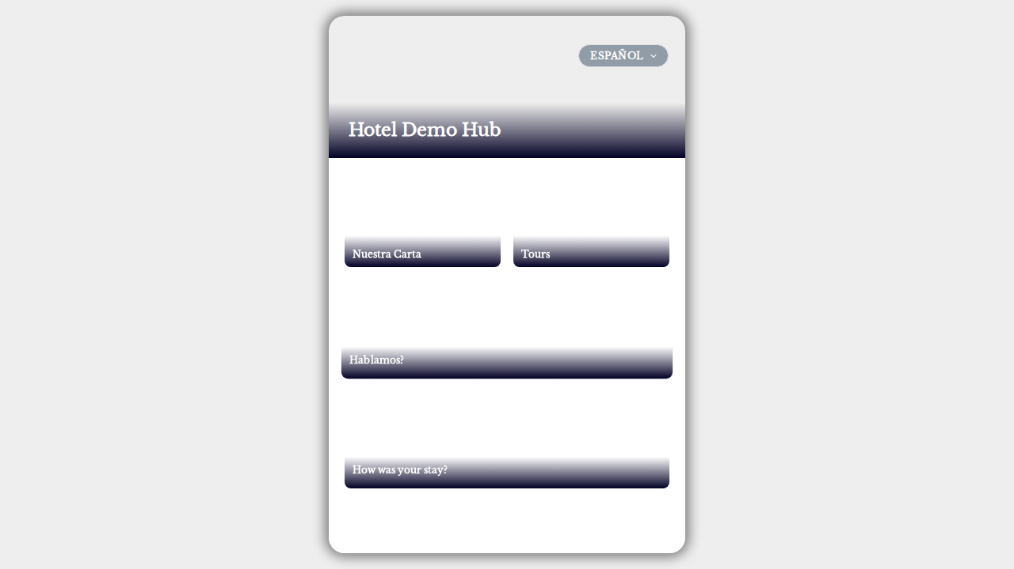
HubOS QA Engineer Homework XGA
22 dic 2025
should not login with double leading zero in room number (B)
const loginPage = new LoginPage(page);
await loginPage.loginWithFandbInputs(WRONG_ROOM, CORRECT_LOGIN4);
await expect(page).toHaveURL(url); // Assert that URL remains unchanged for room with double leading zero
await expect(loginPage.notyfAnnouncer).toContainText(/no.*res.*:/i); // Assert error message: no reservation for room with double leading zero
await expect(loginPage.notyfAnnouncer).toContainText(CORRECT_LOGIN4); // Assert error message: no reservation for room with double leading zero
await expect(loginPage.notyfAnnouncer).toContainText(WRONG_ROOM); // Assert error message: no reservation for room with double leading zero
HubOS
Page 34

Slide 35

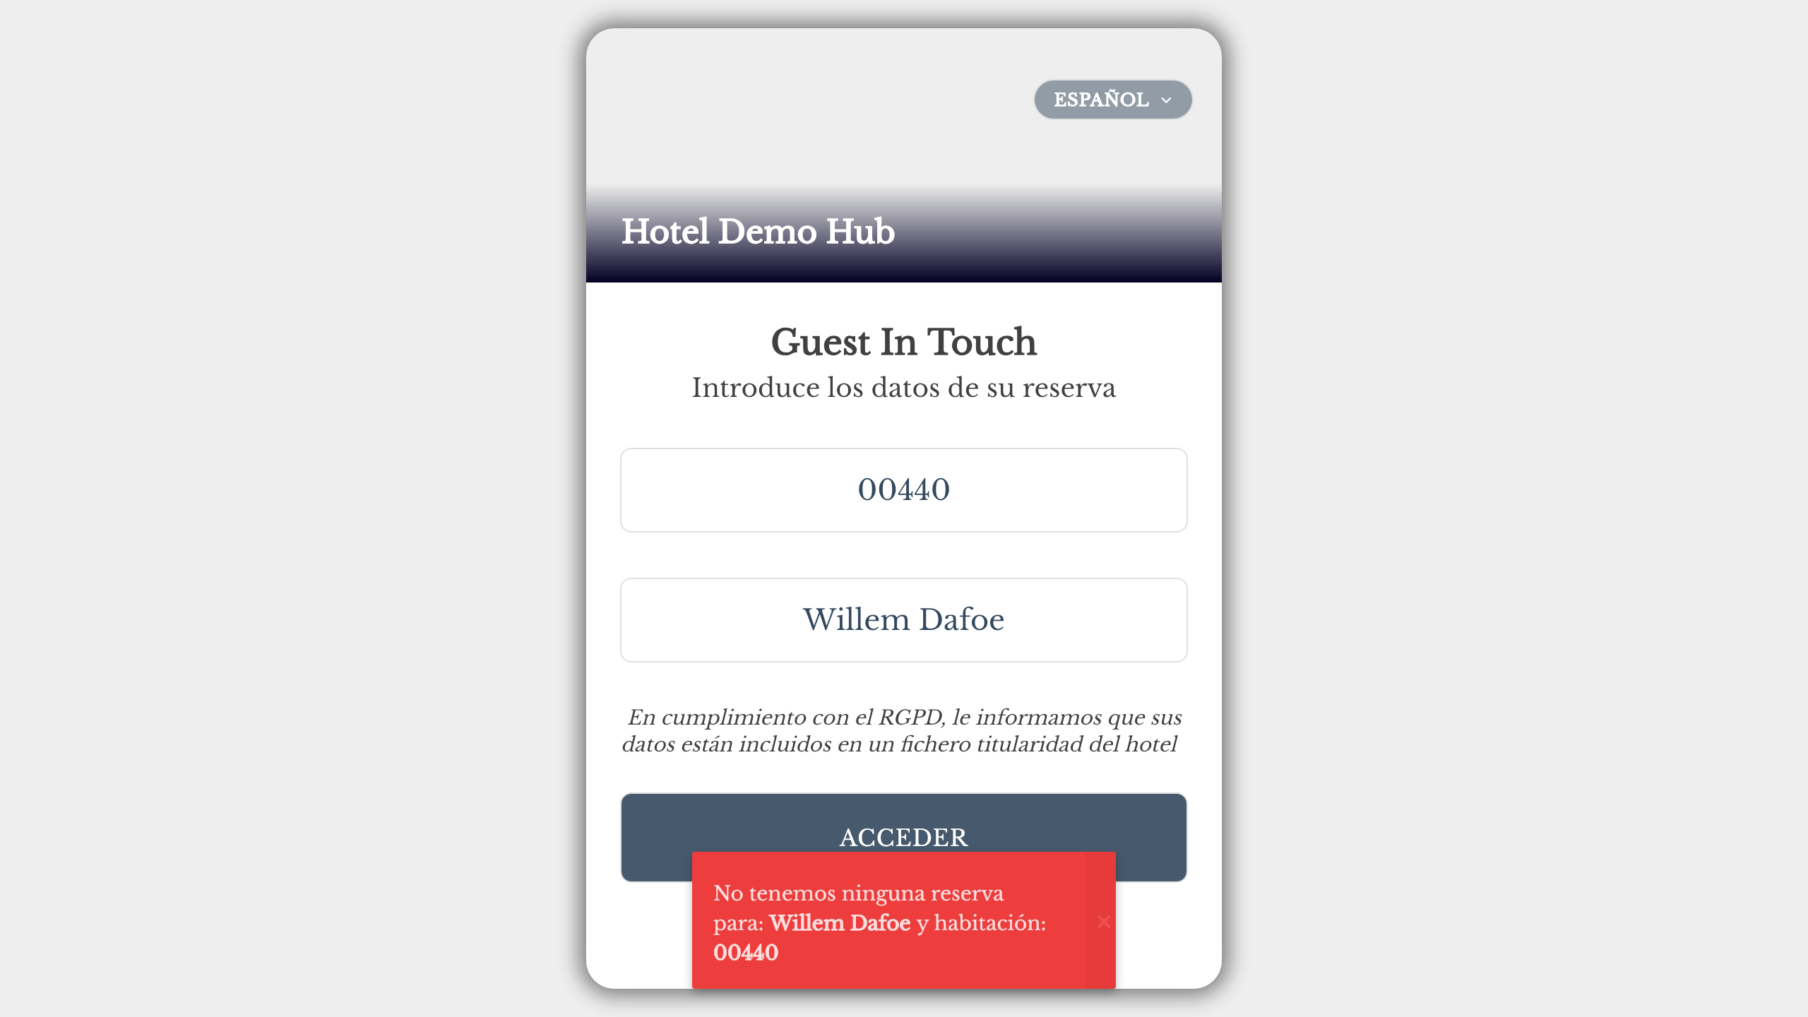
HubOS QA Engineer Homework XGA
22 dic 2025
should (not) allow login with partial name for room 440 (security proof)
// Security proof: This test currently passes due to a vulnerability. If it fails in the future, the vulnerability has been fixed (expected behavior).
const lp = new LoginPage(page);
await lp.fillRoom(ROOM2);
await lp.fillName(CORRECT_LOGIN2);
await lp.submitLogin(ROOM2, true);
await expect(lp.fandbForm).toContainText(ROOM2);
await expect(lp.fandbForm).toContainText(CORRECT_LOGIN4);
HubOS
Page 35

Slide 36
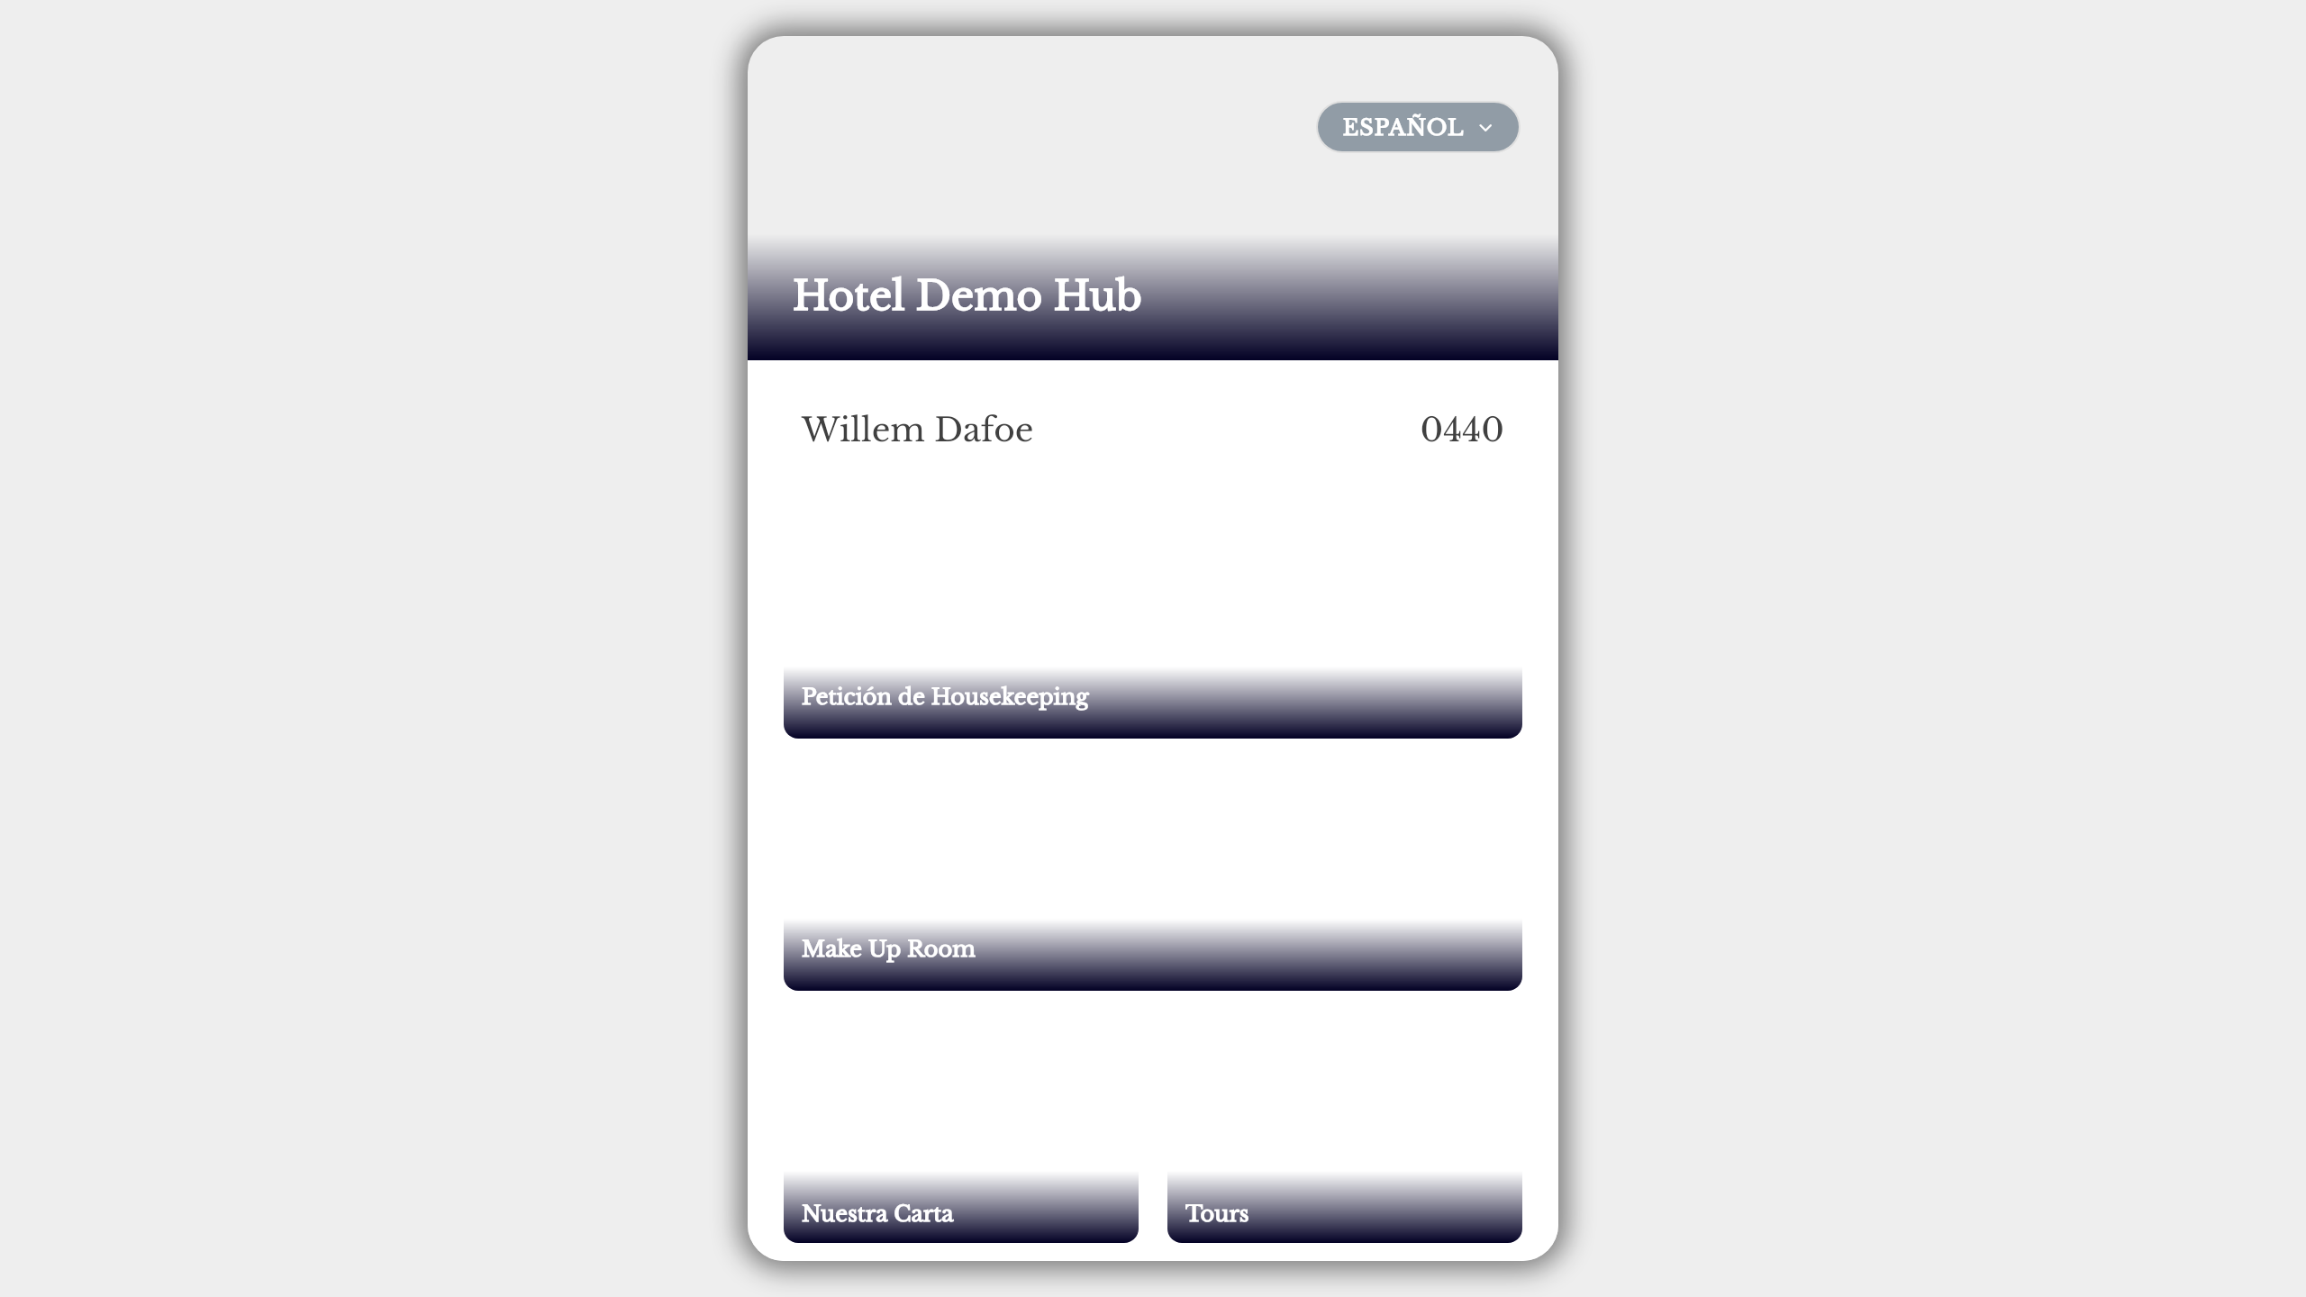
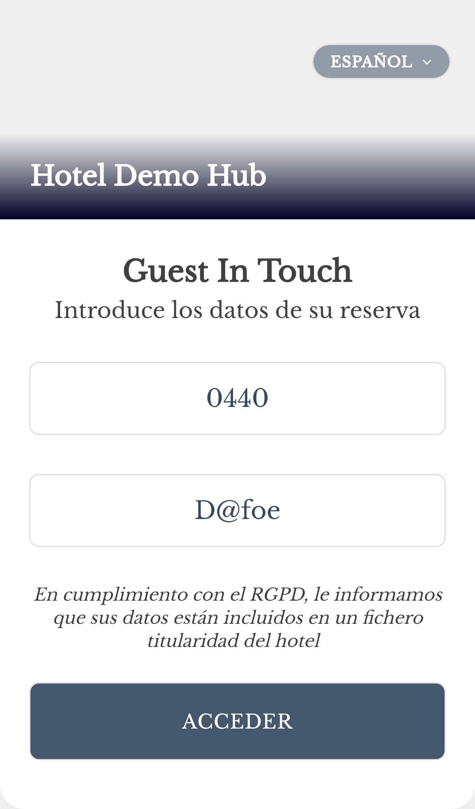
HubOS QA Engineer Homework XGA
22 dic 2025
should (not) allow login with partial name for room 0440 (security proof)
// Security proof: This test currently passes due to a vulnerability. If it fails in the future, the vulnerability has been fixed (expected behavior).
const loginPage = new LoginPage(page);
await loginPage.loginWithRoomAndName(ROOM, CORRECT_LOGIN3);
await expect(loginPage.fandbForm).toContainText(ROOM);
await expect(loginPage.fandbForm).toContainText(CORRECT_LOGIN4);
HubOS
Page 36

Slide 37
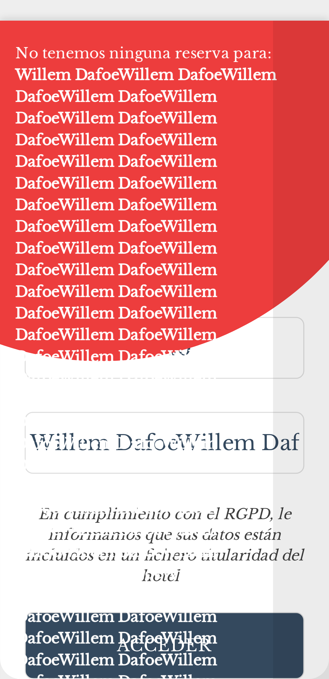

HubOS QA Engineer Homework XGA
22 dic 2025
should login with full name Willem Dafoe (0440) (A)
const lp = new LoginPage(page);
await lp.fillRoom(ROOM);
await lp.fillName(CORRECT_LOGIN4);
await lp.submitLogin(ROOM, true);
// Recheck that login is successful and the correct room, name, and hotel are displayed
await expect(lp.fandbForm).toContainText(ROOM);
await expect(lp.fandbForm).toContainText(CORRECT_LOGIN4);
await expect(lp.hotelName).toContainText(DEMOHUB);
HubOS
Page 37

Slide 38


HubOS QA Engineer Homework XGA
22 dic 2025
should login with full name Willem Dafoe (0440) (B)
const loginPage = new LoginPage(page);
await loginPage.loginWithFandbInputs(ROOM, CORRECT_LOGIN4);
await expect(page).not.toHaveURL(url);
// Recheck that login is successful and the correct room, name, and hotel are displayed
await expect(loginPage.fandbForm).toContainText(ROOM);
await expect(loginPage.fandbForm).toContainText(CORRECT_LOGIN4);
await expect(loginPage.hotelName).toContainText(DEMOHUB);
HubOS
Page 38

Slide 39
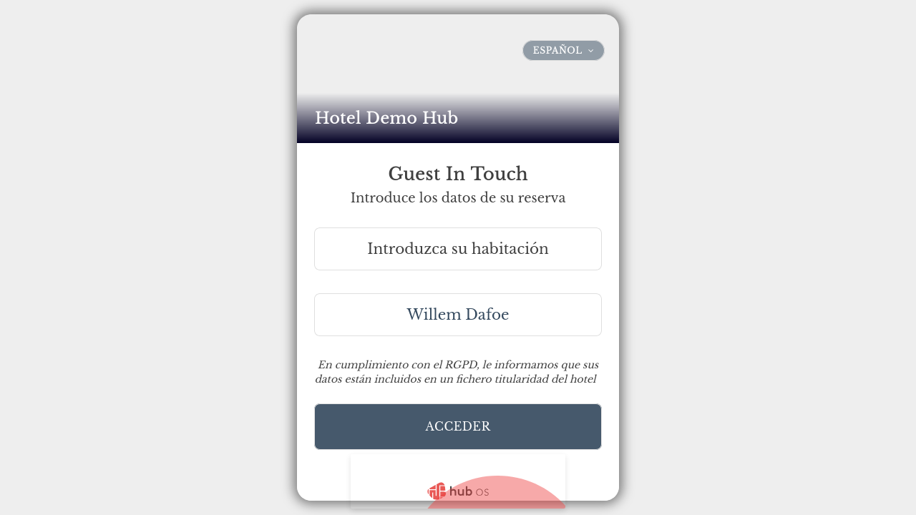
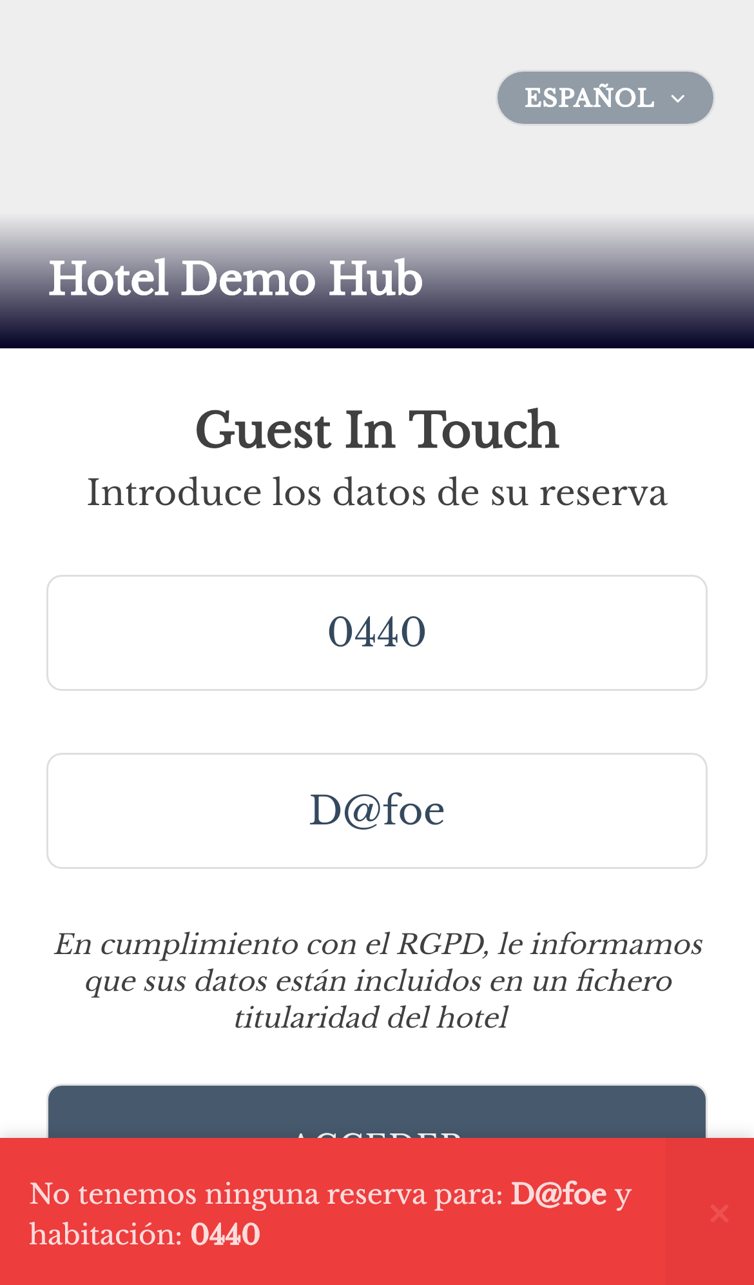
HubOS QA Engineer Homework XGA
22 dic 2025
should login with full name Willem Dafoe (440) (A)
const lp = new LoginPage(page);
await lp.fillRoom(ROOM2);
await lp.fillName(CORRECT_LOGIN4);
await lp.submitLogin(ROOM2, true);
await lp.assertLoggedIn(ROOM2, CORRECT_LOGIN4, 15000);
HubOS
Page 39

Slide 40


HubOS QA Engineer Homework XGA
22 dic 2025
should login with full name Willem Dafoe (440) (B)
const loginPage = new LoginPage(page);
await loginPage.loginWithFandbInputs(ROOM2, CORRECT_LOGIN4, true);
await loginPage.assertLoggedIn(ROOM2, CORRECT_LOGIN4, 15000);
HubOS
Page 40

Slide 41


HubOS QA Engineer Homework XGA
22 dic 2025
should login with full name Willem Dafoe (0440)
const loginPage = new LoginPage(page);
await loginPage.loginWithRoomAndName(ROOM, CORRECT_LOGIN4);
// Recheck that login is successful and the correct room, name, and hotel are displayed
await expect(loginPage.fandbForm).toContainText(ROOM);
await expect(loginPage.fandbForm).toContainText(CORRECT_LOGIN4);
await expect(loginPage.hotelName).toContainText(DEMOHUB);
HubOS
Page 41

Slide 42


HubOS QA Engineer Homework XGA
22 dic 2025
should login with full name Willem Dafoe (440)
const loginPage = new LoginPage(page);
await loginPage.loginWithRoomAndName(ROOM2, CORRECT_LOGIN4);
await expect(page).not.toHaveURL(url);
// Recheck that login is successful and the correct room, name, and hotel are displayed
await loginPage.assertLoggedIn(ROOM2, CORRECT_LOGIN4, 15000);
HubOS
Page 42

